Slide 1
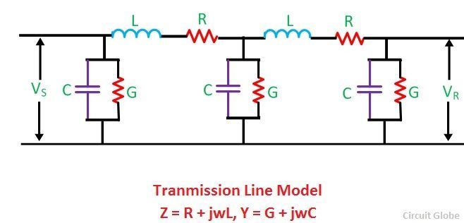
Chapter 4:
Transmission Line Parameters
4.1. Transmission line resistance (R) and conductance (G);
4.2. Transmission line inductance (L);
4.2.1. Inductance of a single conductor;
4.2.2. Inductance of a single-phase line;
4.2.3. Inductance of a symmetric three-phase transmission line;
4.2.4. Inductance of an asymmetric three-phase transmission line;
4.2.5. Inductance of an asymmetric transposed three-phase transmission line;
4.2.5. Inductance of the bundled (stranded) conductors;
4.2.5. Inductance of the three-phase double-circuit line;
4.3. Transmission line capacitance (C);
4.3.1. Capacitance of a single conductor;
4.3.2. Capacitance of a single-phase line;
4.3.3. Capacitance of an asymmetric three-phase transmission line;
4.3.4. Capacitance of the bundled (stranded) conductors;
4.3.5. Capacitance of the three-phase double-circuit line;
4.4. Magnetic field induction;

Slide 2
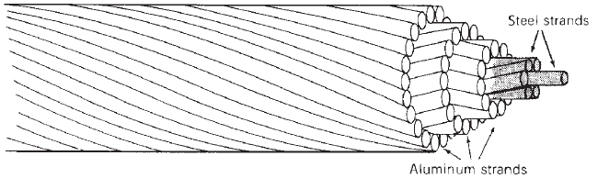
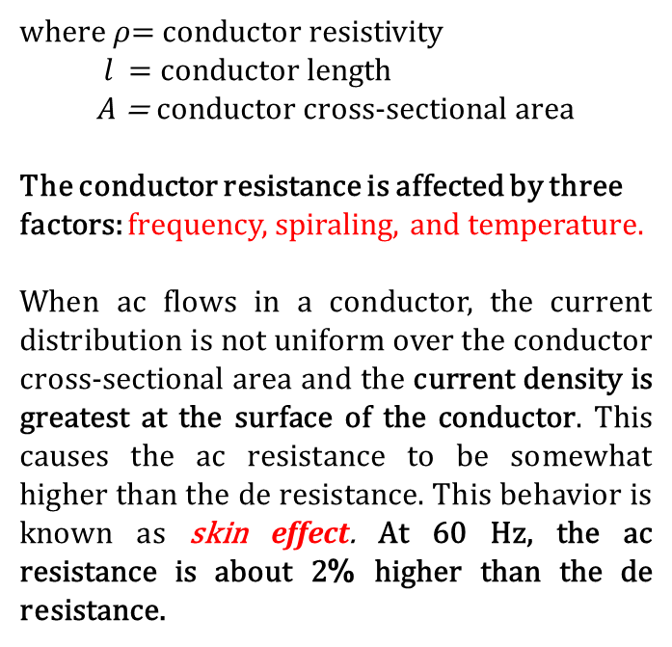

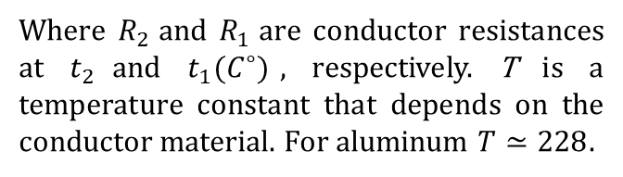

4.1. Transmission line resistance (R) and conductance (G)
$$R_{dc}=\frac{ρl}{A}$$
(4-1)
where $ρ$= conductor resistivity
$l$= conductor length
$A$ = conductor cross-sectional area
The conductor resistance is affected by three factors: frequency, spiraling, and temperature.
When ac flows in a conductor, the current distribution is not uniform over the conductor cross-sectional area and the current density is greatest at the surface of the conductor. This causes the ac resistance to be somewhat higher than the de resistance. This behavior is known as skin effect. At 60 Hz, the ac resistance is about 2% higher than the de resistance.
$$R_{2}=R_{1}\frac{T+t_{2}}{T+t_{1}}$$
(4-2)
Where $R_{2}$and $R_{1}$are conductor resistances at $t_{2}$and $t_{1}(C^{∘})$, respectively. T is a temperature constant that depends on the conductor material. For aluminum $T≃228.$

Slide 3
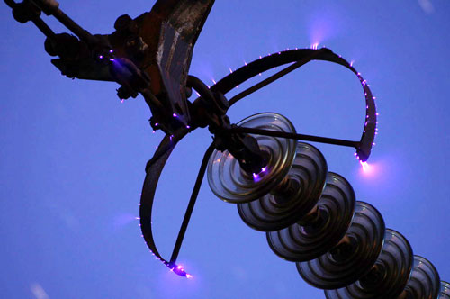
When the surface potential gradient of a conductor exceeds the dielectric strength of the surrounding air, ionization occurs in the area close to the conductor surface. This partial ionization is known as corona. The dielectric strength of air during fair weather and at NTP (25°C and 76cm of Hg) is about 30 kV/cm.
Corona produces:
power loss;
ozone production;
radio and television interference;
audible hissing sound in the vicinity of the line;
The audible noise is an environmental concern and occurs in foul weather. Radio interference occurs in the AM band. Rain and snow may produce moderate TVI in a low signal area.
Corona is a function of conductor diameter, line configuration, type of conductor, and condition of its surface. Atmospheric conditions such as air density, humidity, and wind influence the generation of corona. Corona losses in rain or snow are many times the losses during fair weather. On a conductor surface, an irregularity such as a contaminating particle causes a voltage gradient that may become the point source of a discharge. Also, insulators are contaminated by dust or chemical deposits which will lower the disruptive voltage and increase the corona loss. The insulators are cleaned periodically to reduce the extent of the problem. Corona can be reduced by increasing the conductor size and the use of conductor bundling.
The corona ring distributes the electric field (or charge) across a wider area, because of its smooth round shape. Hence, it reduces the potential gradient below the critical disruptive value.
The power loss associated with corona can be represented by shunt conductance (G or g). However, under normal operating conditions g, which represents the resistive leakage between a phase and ground, has negligible effect on performance and is customarily neglected, (i.e., g = 0).

Slide 4
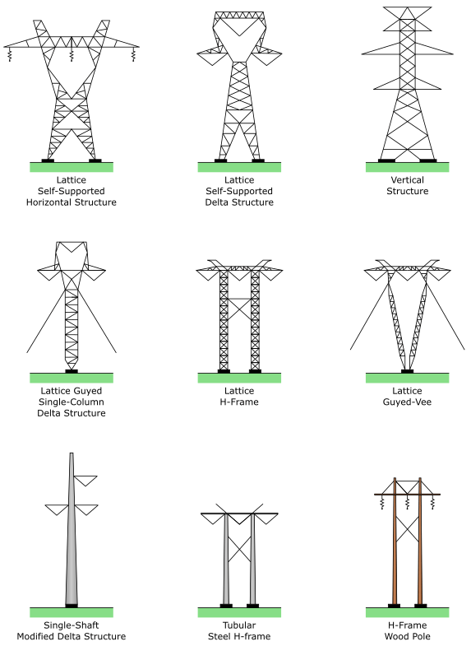
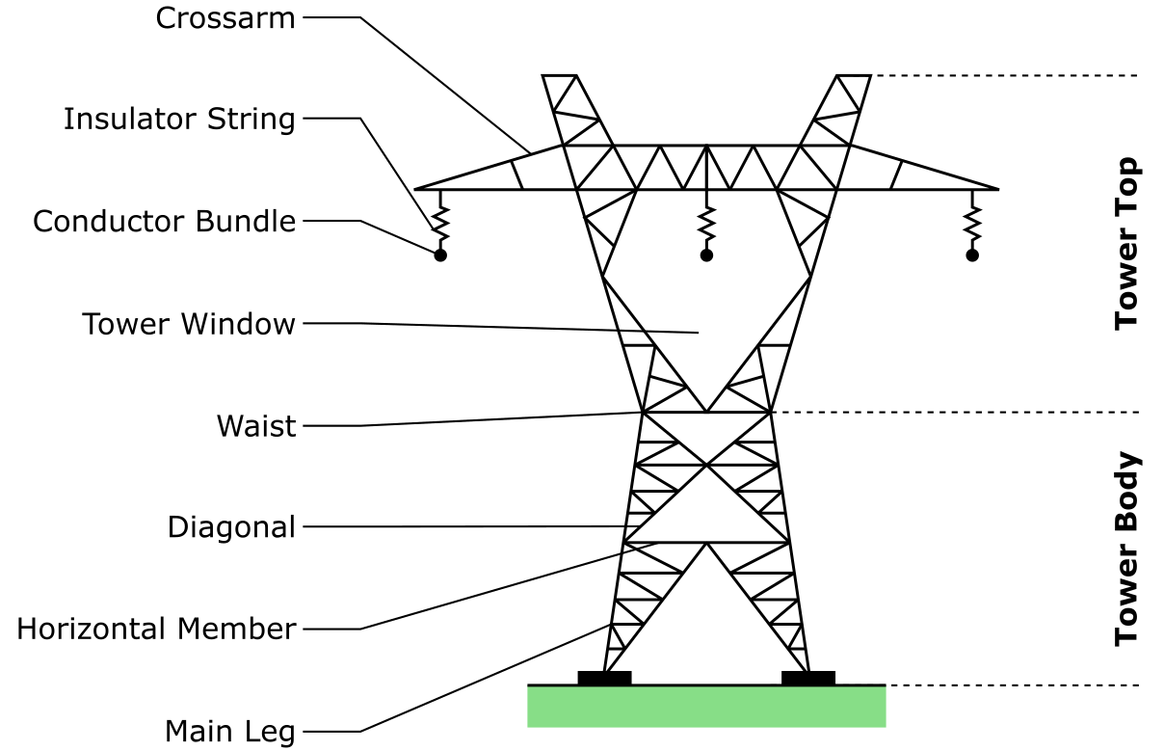

Slide 5
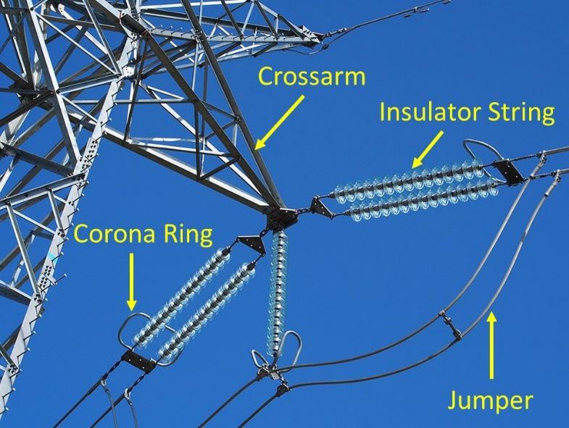
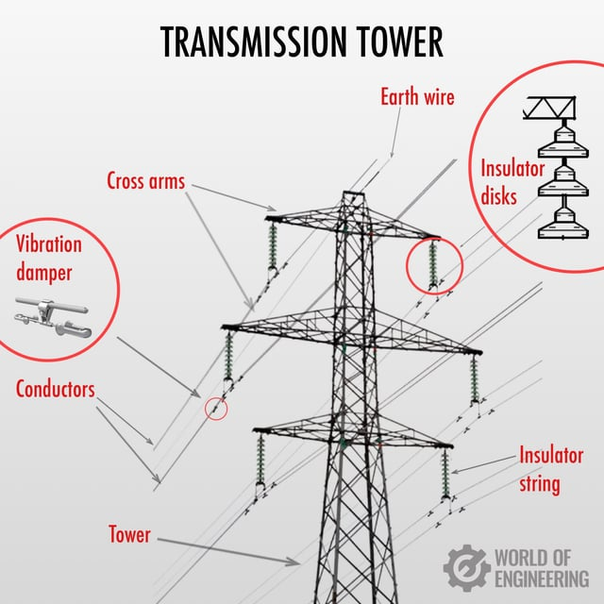
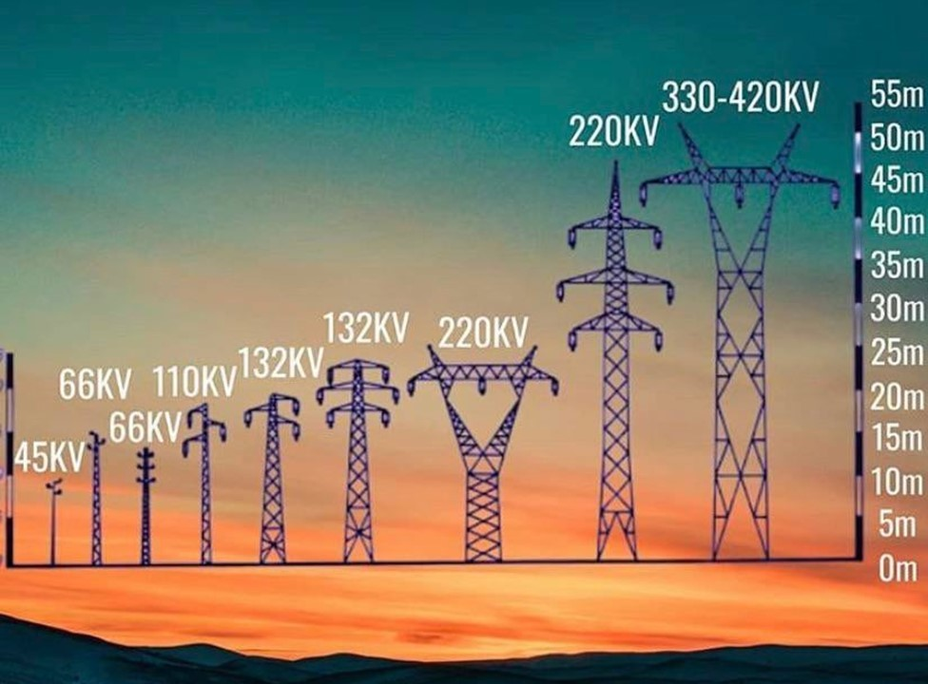

Slide 6
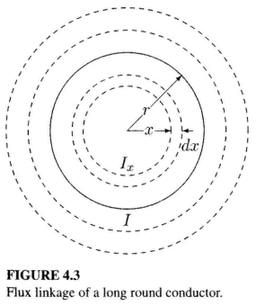


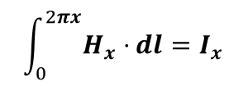
4.2. Transmission line inductance (L)
$$L=\frac{λ}{I}$$
(4-3)
where $λ=$flux linkages, in Weber turns.
4.2.1. Inductance of a single conductor
The magnetic field intensity $H_{x}$, around a circle of radius $x$, is constant and tangent to the circle. The Ampere’s law relating $H_{x}$ to the current $I_{x}$ is given by
$$\int_{0}^{2πx}{H_{x}⋅}dl=I_{x}$$
(4-4)
or
$$H_{x}=\frac{I_{x}}{2πx}$$
(4-5)

Slide 7


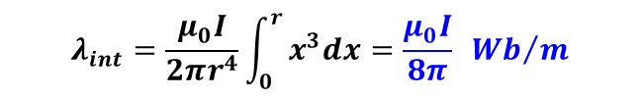


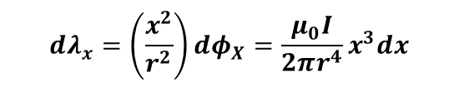

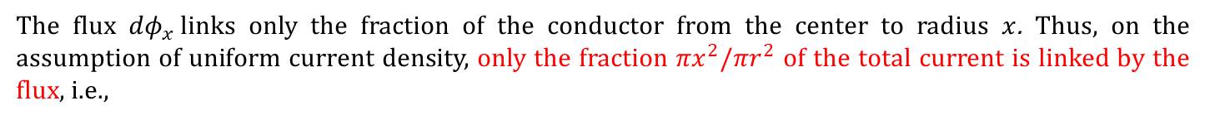
Internal inductance
A simple expression can be obtained for the internal flux linkage by neglecting the skin effect and assuming uniform current density throughout the conductor cross section, i.e.,
$$\frac{I}{πr^{2}}=\frac{I_{x}}{πx^{2}}$$
(4-6)
Substituting for $I_{x}$ in (4.5) yields
$$H_{x}=\frac{I}{2πr^{2}}x$$
(4-7)
For a nonmagnetic conductor with constant permeability $μ_{0}$, the magnetic flux density is given by $B_{x}=μ_{0}H_{x}$, or
$$B_{x}=\frac{μ_{0}I}{2πr^{2}}x$$
(4-8)
where $μ_{0}$is the permeability of free space (or air) and is equal to $4π×{10}^{−7}H$/m.
The differential flux $dφ$ for a small region of thickness $dx$ and one meter length of the conductor is
$${dφ}_{x}=B_{x}dx⋅1=\frac{μ_{0}I}{2πr^{2}}xdx$$
(4-9)
The flux ${dφ}_{x}$links only the fraction of the conductor from the center to radius $x$. Thus, on the assumption of uniform current density, only the fraction ${πx}^{2}/{πr}^{2}$ of the total current is linked by the flux, i.e.,
$$dλ_{x}=\left(\frac{x^{2}}{r^{2}}\right){dφ}_{X}=\frac{μ_{0}I}{2πr^{4}}x^{3}dx$$
(4-10)
The total flux linkage is found by integrating ${dλ}_{x}$ from $0$ to $r$.
$$λ_{int}=\frac{μ_{0}I}{2πr^{4}}\int_{0}^{r}{x^{3}dx=\frac{μ_{0}I}{8π} {Wb}/m}$$
(4-11)
From (4.3), the inductance due to the internal flux linkage is
$$L_{int}=\frac{μ_{0}}{8π}=\frac{1}{2}⨯{10}^{−7}H/m$$
(4-12)
Note that $L_{int}$ is independent of the conductor radius $r$.

Slide 8
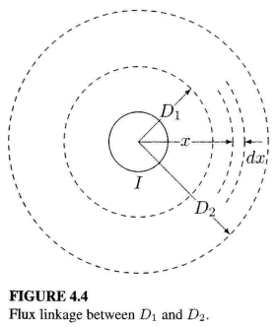
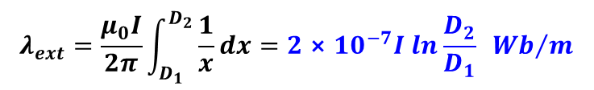
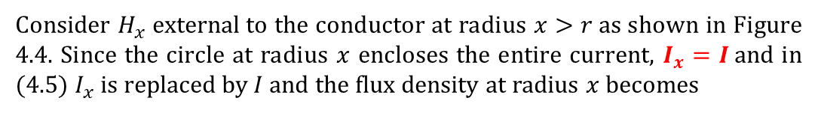

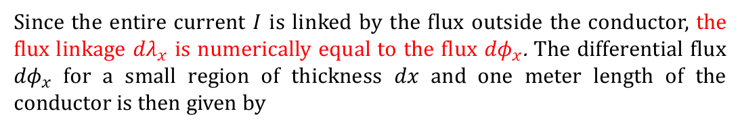


External inductance
Consider $H_{x}$external to the conductor at radius $x>r$as shown in Figure 4.4. Since the circle at radius $x$ encloses the entire current, $I_{x}=I$and in (4.5) $I_{x}$ is replaced by $I$ and the flux density at radius $x$ becomes
$$B_{x}=μ_{0}H_{x}=\frac{μ_{0}I}{2πx}$$
(4-13)
Since the entire current $I$ is linked by the flux outside the conductor, the flux linkage ${dλ}_{x}$ is numerically equal to the flux ${dφ}_{x}$. The differential flux ${dφ}_{x}$ for a small region of thickness $dx$ and one meter length of the conductor is then given by
$$dλ_{x}={dφ}_{X}=B_{x}dx⋅1=\frac{μ_{0}I}{2πx}dx$$
(4-14)
The external flux linkage between two points $D_{1}$and $D_{2}$ is found by integrating ${dλ}_{x}$ from $D_{1}$ to $D_{2}$.
$$λ_{ext}=\frac{μ_{0}I}{2π}\int_{D_{1}}^{D_{2}}{\frac{1}{x}dx}=2⨯{10}^{−7}I ln\frac{D_{2}}{D_{1}} { Wb}/m$$
(4-15)
The inductance between two points external to a conductor is then
$$L_{ext}=2{⨯10}^{−7} \ln{\frac{D_{2}}{D_{1}}} H/m$$
(4-16)
L_{total}=L_{int}+L_{ext}

Slide 9
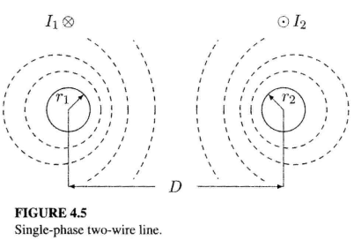

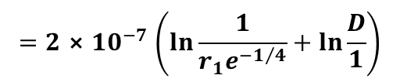

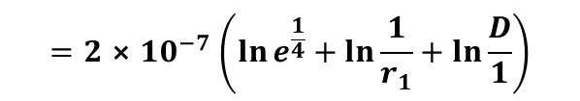
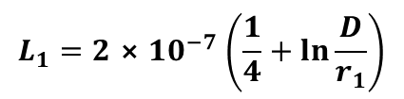
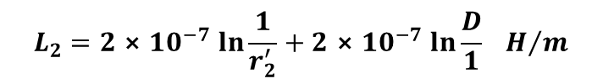

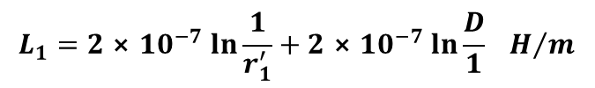
4.2.2. Inductance of a single-phase line
$$L_{1\left(ext\right)}=2{⨯10}^{−7}\ln{\frac{D}{r_{1}}}H/m$$
(4-17)
=>
$$L_{1}=\frac{1}{2}⨯{10}^{−7}+2{⨯10}^{−7}\ln{\frac{D}{r_{1}}}H/m$$
$$L_{1}=2{⨯10}^{−7}\left(\frac{1}{4}+\ln{\frac{D}{r_{1}}}\right)$$
$$=2{⨯10}^{−7}\left(\ln{e^{\frac{1}{4}}}+\ln{\frac{1}{r_{1}}}+\ln{\frac{D}{1}}\right)$$
(4-18)
$$=2{⨯10}^{−7}\left(\ln{\frac{1}{r_{1}e^{−1/4}}}+\ln{\frac{D}{1}}\right)$$
(4-19)
Let $r_{1}^{′}=r_{1}e^{−\frac{1}{4}}$, the inductance of conductor 1 becomes
$$L_{1}=2{⨯10}^{−7}\ln{\frac{1}{r_{1}^{′}}}+2{⨯10}^{−7}\ln{\frac{D}{1}} H/m$$
(4-20)
Similarly, the inductance of conductor 2 is
$$L_{2}=2{⨯10}^{−7}\ln{\frac{1}{r_{2}^{′}}}+2{⨯10}^{−7}\ln{\frac{D}{1}} H/m$$
(4-21)
If the two conductors are identical, $r_{1}=r_{2}=r$and $L_{1}=L_{2}=L$, and the inductance per conductor per meter length of the line is given by
$$L=2{⨯10}^{−7}\ln{\frac{1}{r^{′}}}+2{⨯10}^{−7}\ln{\frac{D}{1}} H/m$$
(4-22)

Slide 10
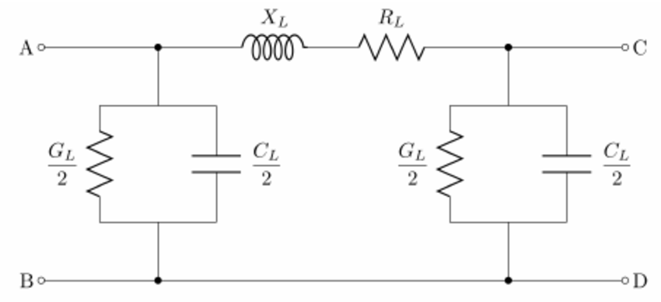

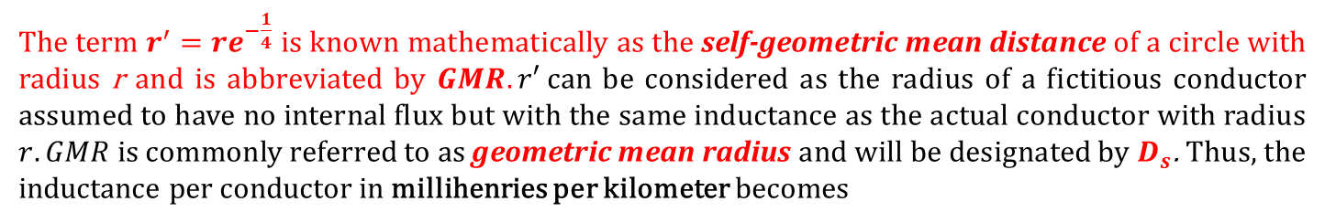
The term $r^{′}=re^{−\frac{1}{4}}$ is known mathematically as the self-geometric mean distance of a circle with radius r and is abbreviated by $GMR. r′$can be considered as the radius of a fictitious conductor assumed to have no internal flux but with the same inductance as the actual conductor with radius $r. GMR$is commonly referred to as geometric mean radius and will be designated by $D_{s}$. Thus, the inductance per conductor in millihenries per kilometer becomes
$$L=0.2\ln{\frac{D}{D_{s}}} {mH}/km$$
(4-23)
=>

Slide 11
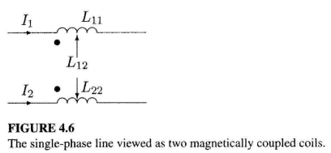
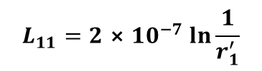





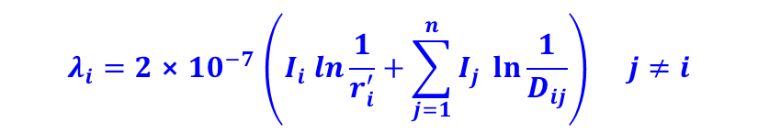


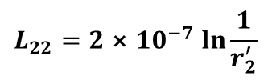

$$λ_{1}=L_{11}I_{1}+L_{12}I_{2}$$
(4-24)
$$λ_{2}=L_{21}I_{1}+L_{22}I_{2}$$
Since $I_{2}=−I_{1}$,we have
$$λ_{1}=\left(L_{11}−L_{12}\right)I_{1}$$
(4-25)
$$λ_{2}=\left(−L_{21}+L_{22}\right)I_{2}$$
Comparing (4.25) with (4.20) and (4.21), we conclude the following equivalent expressions for the self- and mutual inductances:
$$L_{11}=2{⨯10}^{−7}\ln{\frac{1}{r_{1}^{′}}}$$
$$L_{22}=2{⨯10}^{−7}\ln{\frac{1}{r_{2}^{′}}}$$
$$L_{12}=L_{21}=2{⨯10}^{−7}\ln{\frac{1}{D}}$$
(4-26)
The concept of self- and mutual inductance can be extended to a group of $n$ conductors. Consider $n$ conductors carrying phasor currents $I_{1},I_{2},…,I_{n}$, such that
$$I_{1}+I_{2}+…+I_{i}+…+I_{n}=0$$
(4-27)
Generalizing (4.24), the flux linkages of conductor $i$ are
$$λ_{i}=L_{ii}I_{i}+\sum_{j=1}^{n}{L_{ij}I_{j} } j≠i$$
(4-28)
or
$$λ_{i}=2{⨯10}^{−7}\left(I_{i} ln\frac{1}{r_{i}^{′}}+\sum_{j=1}^{n}{I_{j} \ln{\frac{1}{D_{ij}}}}\right) j≠i$$
(4-29)

Slide 12
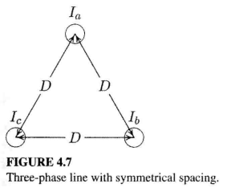
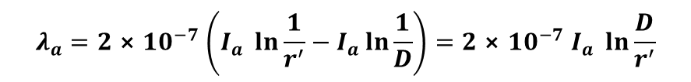
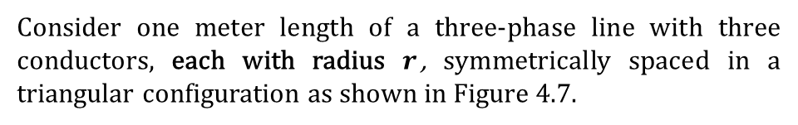
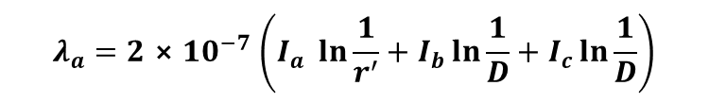


4.2.3. Inductance of a symmetric three-phase transmission line
Consider one meter length of a three-phase line with three conductors, each with radius $r$, symmetrically spaced in a triangular configuration as shown in Figure 4.7.
$$I_{a}+I_{b}+I_{c}=0$$
(4-30)
From (4.29) the total flux linkage of phase a conductor is
$$λ_{a}=2{⨯10}^{−7}\left(I_{a} \ln{\frac{1}{r^{′}}}+I_{b}\ln{\frac{1}{D}}+I_{c}\ln{\frac{1}{D}}\right)$$
(4-31)
Substituting for $I_{b}+I_{c}=−I_{a}$
$$λ_{a}=2{⨯10}^{−7}\left(I_{a} \ln{\frac{1}{r^{′}}}−I_{a}\ln{\frac{1}{D}}\right)=2{⨯10}^{−7}I_{a} \ln{\frac{D}{r^{′}}}$$
(4-32)
Because of symmetry, $λ_{b}=λ_{c}=λ_{a}$, and the three inductances are identical. Therefore, the inductance per phase per kilometer length is
$$L=0.2\ln{\frac{D}{D_{s}}} {mH}/km$$
(4-33)
For a solid round conductor, D_{s} $=re^{−\frac{1}{4}}$, and for a stranded conductor D_{s} can be evaluated from (4.50) at the next slides.

Slide 13
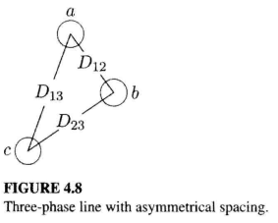
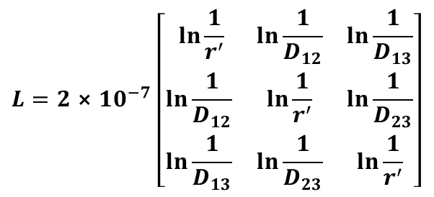
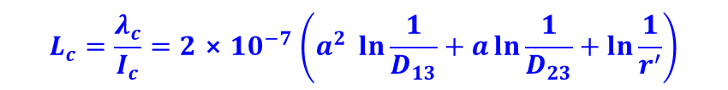
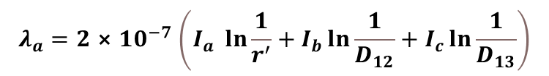
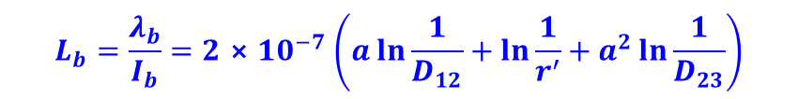

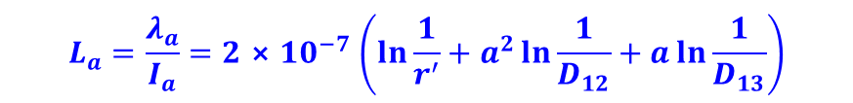
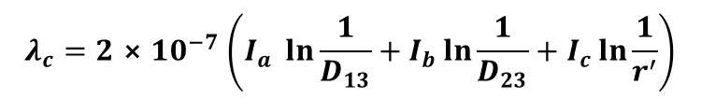
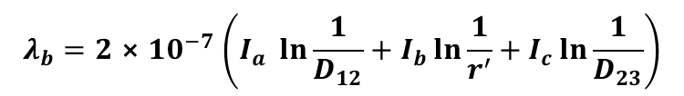
4.2.4. Inductance of an asymmetric three-phase transmission line
The application of (4.29) will result in the following flux linkages.
$$λ_{a}=2{⨯10}^{−7}\left(I_{a} \ln{\frac{1}{r^{′}}}+I_{b}\ln{\frac{1}{D_{12}}}+I_{c}\ln{\frac{1}{D_{13}}}\right)$$
$$λ_{b}=2{⨯10}^{−7}\left(I_{a} \ln{\frac{1}{D_{12}}}+I_{b}\ln{\frac{1}{r^{′}}}+I_{c}\ln{\frac{1}{D_{23}}}\right)$$
(4-34)
$$λ_{c}=2{⨯10}^{−7}\left(I_{a} \ln{\frac{1}{D_{13}}}+I_{b}\ln{\frac{1}{D_{23}}}+I_{c}\ln{\frac{1}{r^{′}}}\right)$$
or in matrix form
$$λ=LI$$
(4-35)
$$L=2{⨯10}^{−7}\left[\begin{matrix} \ln{\frac{1}{r^{′}}} & \ln{\frac{1}{D_{12}}} & \ln{\frac{1}{D_{13}}} \\ \ln{\frac{1}{D_{12}}} & \ln{\frac{1}{r^{′}}} & \ln{\frac{1}{D_{23}}} \\ \ln{\frac{1}{D_{13}}} & \ln{\frac{1}{D_{23}}} & \ln{\frac{1}{r^{′}}}\end{matrix}\right]$$
where the symmetrical inductance matrix $L$ is given by
(4-36)
For balanced three-phase currents with $I_{a}$ as reference, we have
$I_{b}=I_{a}∠240°=a^{2}I_{a}$ & $I_{c}=I_{a}∠120°=aI_{a}$
(4-37)
$$L_{a}=\frac{λ_{a}}{I_{a}}=2{⨯10}^{−7}\left(\ln{\frac{1}{r^{′}}}+a^{2}\ln{\frac{1}{D_{12}}}+a\ln{\frac{1}{D_{13}}}\right)$$
$$L_{b}=\frac{λ_{b}}{I_{b}}=2{⨯10}^{−7}\left(a\ln{\frac{1}{D_{12}}}+\ln{\frac{1}{r^{′}}}+a^{2}\ln{\frac{1}{D_{23}}}\right)$$
(4-38)
$$L_{c}=\frac{λ_{c}}{I_{c}}=2{⨯10}^{−7}\left(a^{2} \ln{\frac{1}{D_{13}}}+a\ln{\frac{1}{D_{23}}}+\ln{\frac{1}{r^{′}}}\right)$$

Slide 14
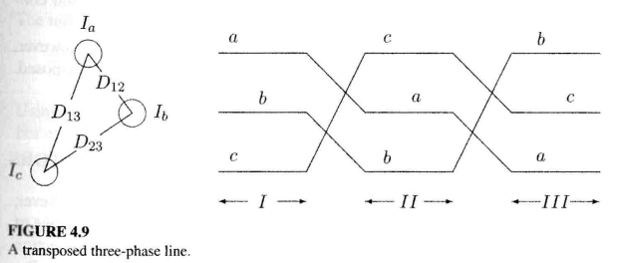



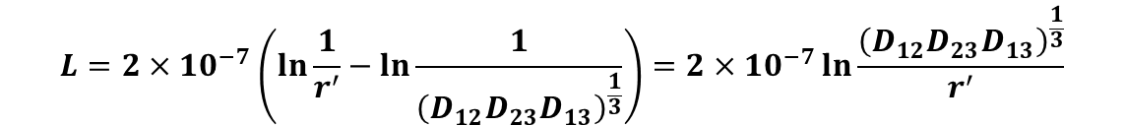
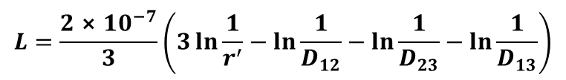
4.2.5. Inductance of an asymmetric transposed three-phase transmission line
Since in a transposed line each phase takes all three positions, the inductance per phase can be obtained by finding the average value of (4.38).
$$L=\frac{L_{a}+L_{b}+L_{c}}{3}$$
(4-39)
Noting $a+a^{2}=1∠{120}^{°}+1∠{240}^{°}=−1$, the average of (4.38) becomes
$$L=\frac{2{⨯10}^{−7}}{3}\left(3\ln{\frac{1}{r^{′}}}−\ln{\frac{1}{D_{12}}}−\ln{\frac{1}{D_{23}}}−\ln{\frac{1}{D_{13}}}\right)$$
or
$$L=2×{10}^{−7}\left(\ln{\frac{1}{r^{′}}−\ln{\frac{1}{{\left(D_{12}D_{23}D_{13}\right)}^{\frac{1}{3}}}}}\right)=2×{10}^{−7}\ln{\frac{{\left(D_{12}D_{23}D_{13}\right)}^{\frac{1}{3}}}{r^{′}}}$$
(4-40)
or the inductance per phase per kilometer length is
$$L=0.2ln\frac{GMD}{D_{s}} {mH}/km$$
(4-41)
where
$$GMD=\sqrt[3]{D_{12}D_{23}D_{13}}$$
(4-42)

Slide 15
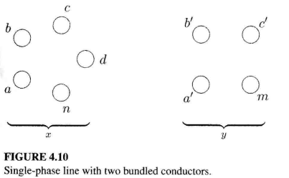
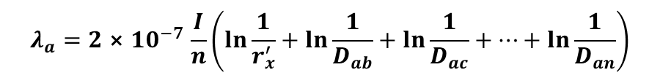
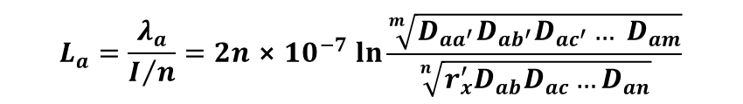

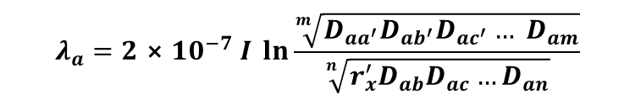


4.2.5. Inductance of the bundled (stranded) conductors
The current is assumed to be equally divided among the subconductors. The current per strand is I/n in x and I/m in y.
$$λ_{a}=2{⨯10}^{−7}\frac{I}{n}\left(\ln{\frac{1}{r_{x}^{′}}}+\ln{\frac{1}{D_{ab}}}+\ln{\frac{1}{D_{ac}}}+…+\ln{\frac{1}{D_{an}}}\right)$$
$$−2{⨯10}^{−7}\frac{I}{m}\left(\ln{\frac{1}{D_{{aa}^{′}}}}+\ln{\frac{1}{D_{{ab}^{′}}}}+\ln{\frac{1}{D_{{ac}^{′}}}}+…+\ln{\frac{1}{D_{am}}}\right)$$
or
$$λ_{a}=2{⨯10}^{−7}I \ln{\frac{\sqrt[m]{D_{{aa}^{′}}D_{{ab}^{′}}D_{{ac}^{′}}… D_{am}}}{\sqrt[n]{r_{x}^{′}D_{ab}D_{ac}…D_{an}}}}$$
The inductance of subconductor $a$ is
$$L_{a}=\frac{λ_{a}}{I/n}=2n{⨯10}^{−7}\ln{\frac{\sqrt[m]{D_{{aa}^{′}}D_{{ab}^{′}}D_{{ac}^{′}}… D_{am}}}{\sqrt[n]{r_{x}^{′}D_{ab}D_{ac}…D_{an}}}}$$
(4-44)
Using (4.29), the inductance of other subconductors in $x$ are similarly obtained. For example, the inductance of the subconductor $n$ is
$$L_{n}=\frac{λ_{n}}{I/n}=2n{⨯10}^{−7} \ln{\frac{\sqrt[m]{D_{{na}^{′}}D_{{nb}^{′}}D_{{nc}^{′}}… D_{nm}}}{\sqrt[n]{r_{x}^{′}D_{na}D_{nb}…D_{nc}}}}$$
(4-45)
The average inductance of any one subconductor in group $x$ is
$$L_{av}=\frac{L_{a}+L_{b}+L_{c}+…+L_{n}}{n}$$
(4-46)

Slide 16






Since all the subconductors of conductor $x$ are electrically parallel, the inductance of $x$ will be
$$L_{x}=\frac{L_{av}}{n}=\frac{L_{a}+L_{b}+L_{c}+…+L_{n}}{n^{2}}$$
(4-47)
substituting the values of $L_{a},L_{b},L_{c},…,L_{n}$in (4.47) results in
$$L_{x}=2{⨯10}^{−7} ln\frac{GMD}{{GMR}_{x}} H/meter$$
(4-48)
where
$$GMD=\sqrt[mn]{\left(D_{{aa}^{′}}D_{{ab}^{′}}… D_{am}\right)…\left(D_{{na}^{′}}D_{{nb}^{′}}…D_{nm}\right)}$$
(4-49)
and
$${GMR}_{x}=\sqrt[n^{2}]{\left(D_{aa}D_{ab}… D_{an}\right)…\left(D_{na}D_{nb}…D_{nn}\right)}$$
(4-50)
where $D_{aa}=D_{bb}⋯=D_{nn}=r_{x}^{′}$
The inductance of conductor $𝓨$ can also be similarly obtained. The geometric mean radius ${GMR}_{𝓨}$ will be different. The geometric mean distance $GMD$, however, is the same.
Examples of bundled arrangements (2, 3, and 4 subconductor)
$$D_{s}^{b}=\sqrt[4]{{\left(D_{s}⨯d\right)}^{2}}=\sqrt{D_{s}⨯d}$$
(4-51)
$$D_{s}^{b}=\sqrt[9]{{\left(D_{s}⨯d⨯d\right)}^{3}}=\sqrt[3]{D_{s}⨯d^{2}}$$
(4-52)
$$D_{s}^{b}=\sqrt[16]{{\left(D_{s}⨯d⨯d⨯d⨯2^{\frac{1}{2}}\right)}^{4}}=1.09\sqrt[4]{D_{s}⨯d^{3}}$$
(4-53)

Slide 17







Example 4.1: A stranded conductor consists of seven identical strands each having a radius $r$ as shown in Figure 4.11. Determine the $GMR$ of the conductor in terms of $r$.
Solution
From Figure 4.11, the distance from strand 1 to all other strands is:
$$D_{12}{=D}_{16}=D_{17}=2r$$
$$D_{14}=4r$$
$$D_{13}{=D}_{15}=\sqrt{D_{14}^{2}−D_{45}^{2}}=2\sqrt{3}r$$
From (4.50) the $GMR$ of the above conductor is
$$GMR=\sqrt[49]{{\left(r^{′}⋅2r⋅2\sqrt{3}r⋅4r⋅2\sqrt{3}r⋅2r⋅2r\right)}^{6}⋅r^{′}{\left(2r\right)}^{6}}$$
$$=r\sqrt[7]{{\left(e\right)}^{−\frac{1}{4}}{\left(2\right)}^{6}{\left(3\right)}^{\frac{6}{7}}{\left(2\right)}^{\frac{6}{7}}}=2.1767r$$
*********************************************************************
Bundling reduces the line reactance, which improves the line performance and increases the power capability of the line. Bundling also reduces the voltage surface gradient, which in turn reduces corona loss, radio interference, and surge impedance.
The subconductors within a bundle are separated at frequent intervals by spacer-dampers.

Slide 18












4.2.5. Inductance of the three-phase double-circuit line
The method of $GMD$ can be used to find the inductance per phase. To do this, we group identical phases together and use (4.49) to find the $GMD$ between each phase group
$$D_{AB}=\sqrt[4]{D_{a_{1}b_{1}}D_{a_{1}b_{2}}D_{a_{2}b_{1}}D_{a_{2}b_{2}}}$$
$$D_{BC}=\sqrt[4]{D_{b_{1}c_{1}}D_{b_{1}c_{2}}D_{b_{2}c_{1}}D_{b_{2}c_{2}}}$$
(4-54)
$$D_{AC}=\sqrt[4]{D_{a_{1}c_{1}}D_{a_{1}c_{2}}D_{a_{2}c_{1}}D_{a_{2}c_{2}}}$$
The equivalent $GMD$ per phase is then
$$GMD=\sqrt[3]{D_{AB}D_{BC}D_{AC}}$$
(4-55)
Similarly, from (4.50), the $GMR$ of each phase group is
$$D_{SA}=\sqrt[4]{{\left(D_{s}^{b}D_{a_{1}a_{2}}\right)}^{2}}=\sqrt{D_{s}^{b}D_{a_{1}a_{2}}}$$
$$D_{SB}=\sqrt[4]{{\left(D_{s}^{b}D_{b_{1}b_{2}}\right)}^{2} }=\sqrt{D_{s}^{b}D_{b_{1}b_{2}}}$$
(4-56)
$$D_{SC}=\sqrt[4]{{\left(D_{s}^{b}D_{c_{1}c_{2}}\right)}^{2}}=\sqrt{D_{s}^{b}D_{c_{1}c_{2}}}$$
The equivalent $GMR$ per phase is then
$${GMR}_{L}=\sqrt[3]{D_{SA}D_{SB}D_{SC}}$$
(4-57)
The inductance per phase in millihenries per kilometer is
$$L=0.2\ln{\frac{GMD}{{GMR}_{L}}} { mH}/km$$
(4-58)

Slide 19







4.3. Transmission line capacitance (C)
$$C=\frac{q}{V}$$
(4-59)
4.3.1. Capacitance of a single conductor
$$D=\frac{q}{A}=\frac{q}{2πx\left(1\right)}$$
(4-60)
The electric field intensity E may be found from the relation
$$E=\frac{D}{ε_{0}}$$
(4-61)
where $ε_{0}$ is the permittivity of free space and is equal to $8.85×{10}^{−12} F/m$. Substituting (4.60) in (4.61) results in
$$E=\frac{q}{2πε_{0}x}$$
(4-62)
The potential difference between cylinders from position $D_{1}$to $D_{2}$ is defined as the work done in moving a unit charge of one coulomb from $D_{2}$ to $D_{1}$ through the electric field produced by the charge on the conductor. This is given by
$$V_{12}=\int_{D_{1}}^{D_{2}}{Edx=\int_{D_{1}}^{D_{2}}{\frac{q}{2πε_{0}x}dx=\frac{q}{2πε_{0}} \ln{\frac{D_{2}}{D_{1}}}}}$$
(4-63)
The notation $V_{12}$ implies the voltage drop from 1 relative to 2, that is, 1 is understood to be positive relative to 2. The charge q carries its own sign.

Slide 20








4.3.2. Capacitance of a single-phase line
Assuming conductor 1 alone to have a charge of $q_{1}$ the voltage between conductor 1 and 2 is
$$V_{12\left(q_{1}\right)}=\frac{q_{1}}{2πε_{0}}\ln{\frac{D}{r}}$$
(4-64)
Now assuming only conductor 2, having a charge of $q_{2}$, the voltage between conductors 2 and 1 is
$$V_{21\left(q_{2}\right)}=\frac{q_{2}}{2πε_{0}}\ln{\frac{D}{r}}$$
Since $V_{12(q_{2})}=−V_{21(q_{2})}$, we have
$$V_{12\left(q_{2}\right)}=\frac{q_{2}}{2πε_{0}}\ln{\frac{r}{D}}$$
(4-65)
From the principle of superposition, the potential difference due to presence of both charges is
$$V_{12}=V_{12\left(q_{1}\right)}{+V}_{12\left(q_{2}\right)}=\frac{q_{1}}{2πε_{0}}\ln{\frac{D}{r}+}\frac{q_{2}}{2πε_{0}}\ln{\frac{r}{D}}$$
(4-66)
For a single-phase line $q_{2}=−q_{1}=−q,$and (4.66) reduces to
$$V_{12}=\frac{q}{πε_{0}}\ln{\frac{D}{r}}$$
(4-67)
From (4.59), the capacitance between conductors is
$$C_{12}=\frac{πε_{0}}{\ln{\frac{D}{r}}}F/m$$
(4-68)

Slide 21







voltage to neutral is half of $V_{12}$, the capacitance to neutral $C={2C}_{12}$, or
$$C=\frac{2πε_{0}}{\ln{\frac{D}{r}}}F/m$$
(4-69)
Recalling $ε_{0}=8.85×{10}^{−12}F/m$and converting to $μ$F per kilometer, we have
$$C=\frac{0.0556}{\ln{\frac{D}{r}}}{μF}/km$$
(4-70)
Consider $n$ parallel long conductors with charges $q_{1},q_{2},…,q_{n}$coulombs/meter, as shown in Figure 4.17.
$$q_{1}+q_{2}+…+q_{n}=0$$
(4-71)
Using superposition and (4.63), potential difference between conductors $i$ and $j$ due to the presence of all charges is
$$V_{ij}=\frac{1}{2πε_{0}}\sum_{k=1}^{n}{q_{k}\ln{\frac{D_{kj}}{D_{ki}}}}$$
(4-72)
When $k=i,D_{ii}$is the distance between the surface of the conductor and its center, namely its radius $r$.

Slide 22






4.3.3. Capacitance of an asymmetric three-phase transmission line
Consider one meter length of a three-phase line with three long conductors, each with radius $r$, with conductor spacing as shown Figure 4.18.
Since we have a balanced three-phase system
$$q_{a}+q_{b}+q_{c}=0$$
(4-73)
Similarly, For the first, second, and third sections of the transposition, we have
$$V_{ab\left(I\right)}=\frac{1}{2πε_{0}}\left(q_{a}\ln{\frac{D_{12}}{r}+q_{b}\ln{\frac{r}{D_{12}}+}q_{c}\ln{\frac{D_{23}}{D_{13}}}}\right)$$
(4-74)
$$V_{ab\left(II\right)}=\frac{1}{2πε_{0}}\left(q_{a}\ln{\frac{D_{23}}{r}+q_{b}\ln{\frac{r}{D_{23}}+}q_{c}\ln{\frac{D_{13}}{D_{12}}}}\right)$$
(4-75)
$$V_{ab\left(III\right)}=\frac{1}{2πε_{0}}\left(q_{a}\ln{\frac{D_{13}}{r}+q_{b}\ln{\frac{r}{D_{13}}+}q_{c}\ln{\frac{D_{12}}{D_{23}}}}\right)$$
(4-76)
The average value of $V_{ab}$is
$$V_{ab}=\frac{1}{\left(3\right)2πε_{0}}\left(q_{a}\ln{\frac{D_{12}D_{23}D_{13}}{r^{3}}+q_{b}\ln{\frac{r^{3}}{D_{12}D_{23}D_{13}}+}q_{c}\ln{\frac{D_{12}D_{23}D_{13}}{D_{12}D_{23}D_{13}}}}\right)$$
(4-77)
or
$$V_{ab}=\frac{1}{2πε_{0}}\left(q_{a}\ln{\frac{{\left(D_{12}D_{23}D_{13}\right)}^{\frac{1}{3}}}{r}+q_{b}\ln{\frac{r}{{\left(D_{12}D_{23}D_{13}\right)}^{\frac{1}{3}}}}}\right)$$
(4-78)

Slide 23









$$GMD=\sqrt[3]{D_{12}D_{23}D_{13}}$$
(4-79)
Therefore, $V_{ab}$ is
$$V_{ab}=\frac{1}{2πε_{0}}\left(q_{a}\ln{\frac{GMD}{r}+q_{b}\ln{\frac{r}{GMD}}}\right)$$
(4-80)
Similarly, we find the average voltage $V_{ac}$ as
$$V_{ac}=\frac{1}{2πε_{0}}\left(q_{a}\ln{\frac{GMD}{r}+q_{c}\ln{\frac{r}{GMD}}}\right)$$
(4-81)
Adding (4.80) and (4.81) and substituting for $q_{b}+q_{c}=−q_{a}$ we have
$${V_{ab}+V}_{ac}=\frac{1}{2πε_{0}}\left(2q_{a}\ln{\frac{GMD}{r}−q_{a}\ln{\frac{r}{GMD}}}\right)=\frac{3q_{a}}{2πε_{0}}\ln{\frac{GMD}{r}}$$
(4-82)
For balanced three-phase voltages,
$$V_{ab}=V_{an}∠0°−V_{an}∠−120°$$
$$V_{ac}=V_{an}∠0°−V_{an}∠−240°$$
(4-83)
Therefore,
$$V_{ab}+V_{ac}=3V_{an}$$
(4-84)
Substituting in (4.82), the capacitance per phase to neutral is
$$C=\frac{q_{a}}{V_{an}}=\frac{2πε_{0}}{\ln{\frac{GMD}{r}}}F/m$$
(4-85)
or capacitance to neutral in $μF$ per kilometer is
$$C=\frac{0.0556}{\ln{\frac{GMD}{r}}} {μF}/{km}$$
(4-86)

Slide 24





4.3.4. Capacitance of the bundled (stranded) conductors
The procedure for finding the capacitance per phase for a three-phase transposed line with bundle conductors follows the same steps as the procedure in Section 4.3.3. The capacitance per phase is found to be
$$C=\frac{2πε_{0}}{\ln{\frac{GMD}{r^{b}}}} F/m$$
(4-87)
The effect of bundling is to introduce an equivalent radius $r^{b}$. The equivalent radius $r^{b}$ is similar to the $GMR$ (geometric mean radius) calculated earlier for the inductance with the exception that radius r of each subconductor is used instead of $D_{s}$.
If $d$ is the bundle spacing, we obtain for the two-subconductor bundle
$$r^{b}=\sqrt{r⨯d}$$
(4-88)
for the three-subconductor bundle
$$r^{b}=\sqrt[3]{r⨯d^{2}}$$
(4-89)
for the four-subconductor bundle
$$r^{b}=1.09\sqrt[4]{r⨯d^{3}}$$
(4-90)

Slide 25







4.3.5. Capacitance of the three-phase double-circuit line
Following the procedure of section 4.3.3, the average voltages V_{ac} and V_{an} are calculated and the per-phase equivalent capacitance to neutral is obtained to be
$$C=\frac{2πε_{0}}{\ln{\frac{GMD}{{GMR}_{c}}}} F/m$$
(4-91)
or capacitance to neutral in $μF$per kilometer is
$$C=\frac{0.0556}{\ln{\frac{GMD}{{GMR}_{c}}}} {μF}/{km}$$
(4-92)
The expression for $GMD$ is the same as was found for inductance calculation and is given by (4.55). The ${GMR}_{C}$ of each phase group is similar to the ${GMR}_{L}$, with the exception that in (4.56) $r^{b}$ is used instead of $D_{s}^{b}$. This will result in the following equations
$$r_{A}=\sqrt{r^{b}D_{a_{1}a_{2}}}$$
$$r_{B}=\sqrt{r^{b}D_{b_{1}b_{2}}}$$
(4-93)
$$r_{C}=\sqrt{r^{b}D_{c_{1}c_{2}}}$$
where $r^{b}$ is the geometric mean radius of the bundled conductors given by (4.88) - (4.90). The equivalent geometric mean radius for calculating the per-phase capacitance to neutral is
$${GMR}_{c}=\sqrt[3]{r_{A}r_{B}r_{C}}$$
(4-94)

Slide 26





Example 4.2: A 500-kV three-phase transposed line is composed of one ACSR 1,272,000-cmil, 45/7 Bittern conductor per phase with horizontal conductor configuration as shown in Figure 4.19. The conductors have a diameter of 1.345 in and a $GMR$ of 0.5328 in. Find the inductance and capacitance per phase per kilometer of the line.
Solution
Conductor radius is $r=\frac{1.345}{2×12}=0.056$ft, and ${GMR}_{L}={0.5328}/{12}=0.0444$ft.
$GMD$ is obtained using (4.42)
$$GMD=\sqrt[3]{35⨯35⨯70}=44.097 ft$$
From (4.58) the inductance per phase is
$$L=0.2\ln{\frac{44.097}{0.0444}=1.38 {mH}/{km}}$$
and from (4.92) the capacitance per phase is
$$C=\frac{0.0556}{\ln{\frac{44.097}{0.056}}}=0.0083 {μF}/{km}$$
*********************************************************************

Slide 27







Example 4.3: The line in Example 4.2 is replaced by two $ACSR$ 636,000-cmil, 24/7 Rook conductors which have the same total cross-sectional area of aluminum as one Bittern conductor. The line spacing as measured from the center of the bundle is the same as before and is shown in Figure 4.20. The conductors have a diameter of 0.977 in and a $GMR$ of 0.3924 in. Bundle spacing is 18 in. Find the inductance and capacitance per phase per kilometer of the line and compare it with that of Example 4.2.
Solution
Conductor radius is $r=\frac{0.977}{2}=0.4885$ in, and from Example 4.2, $GMD=44.097$ft. The equivalent geometric mean radius with two conductors per bundle, for calculating inductance and capacitance, are given by (4.51) and (4.88)
$${GMR}_{L}=\frac{\sqrt{d⨯D_{s}}}{12}=\frac{\sqrt{18⨯0.3924}}{12}=0.22147 ft$$
and
$${GMR}_{c}=\frac{\sqrt{d⨯r}}{12}=\frac{\sqrt{18⨯0.4885}}{12}=0.2471 ft$$
From (4.58) the inductance per phase is
$$L=0.2\ln{\frac{44.097}{0.22147}=1.0588} {mH}/{km}$$
and from (4.92) the capacitance per phase is
$$C=\frac{0.0556}{\ln{\frac{44.097}{0.2471}}}=0.0107 {μF}/{km}$$
*********************************************************************

Slide 28








4.4. Magnetic field induction
Example 4.4: A three-phase untransposed transmission line and a telephone line are supported on the same towers as shown in Figure 4.24. The power line carries a 60-Hz balanced current of 200 A per phase. The telephone line is located directly below phase $b$. Assuming balanced three-phase currents in the power line, find the voltage per kilometer induced in the telephone line.
Solution
From (4.15) the flux linkage between conductors 1 and 2 due to current $I_{a}$ is
$$λ_{12\left(I_{a}\right)}=0.2I_{a}\ln{\frac{D_{a2}}{D_{a1}}} {mWb}/{km}$$
Since $D_{b1}=D_{b2},λ_{12}$ due to $I_{b}$, is zero. The flux linkage between conductors 1 and 2 due to current $I_{c}$is
$$λ_{12\left(I_{c}\right)}=0.2I_{c}\ln{\frac{D_{c2}}{D_{c1}}}{ mWb}/{km}$$
Total flux linkage between conductors 1 and 2 due to all currents is
$$λ_{12}=0.2I_{a}\ln{\frac{D_{a2}}{D_{a1}}+0.2I_{c}}\ln{\frac{D_{c2}}{D_{c1}}}{ mWb}/{km}$$
For positive phase sequence, with $I_{a}$ as reference, $I_{c}=I_{a}∠−240°$and we have
$$λ_{12}=0.2I_{a}\left(\ln{\frac{D_{a2}}{D_{a1}}+1∠−240°}\ln{\frac{D_{c2}}{D_{c1}}}\right) {mH}/{km}$$
With $I_{a}$ as reference, the instantaneous flux linkage is
$$λ_{12}(t)=\sqrt{2}\left|λ_{12}\right|\cos\left(ωt+α\right)$$

Slide 29




Thus, the induced voltage in the telephone line per kilometer length is
$$v=\frac{dλ_{12}\left(t\right)}{dt}=\sqrt{2}ω\left|λ_{12}\right|\cos\left(ωt+α+90°\right)$$
The rms voltage induced in the telephone line per kilometer is
$$V=ω\left|λ_{12}\right|∠α+90°=jωλ_{12}$$
From the circuits geometry
$$D_{a1}=D_{c2}={\left(3^{2}+4^{2}\right)}^{\frac{1}{2}}=5 m$$
$$D_{a2}=D_{c1}={\left({4.2}^{2}+4^{2}\right)}^{\frac{1}{2}}=5.8 m$$
The total flux linkage is
$$λ_{12}=0.2×200∠0^{°}\ln{\frac{5.8}{5}}+0.2×200∠−{240}^{°}\ln{\frac{5}{5.8}=10.283∠{−30}^{°} mWb/km}$$
The voltage induced in the telephone line per kilometer is
$$V=jωλ_{12}=j2π60\left(10.283∠{−30}^{°}\right)\left({10}^{−3}\right)=3.88∠{60}^{°} V/km$$
*********************************************************************

