Slide 1
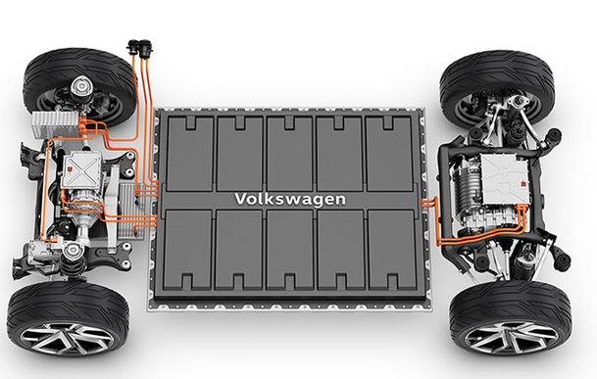
Chapter 3:
Applied Electric Motors (EMs) and Their Drivers as the Propulsion System in EVs

Slide 2
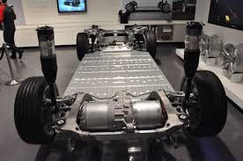
3.1. General overview of EMs and drive systems
An Electric Motor (EM) converts electrical energy that it gets from the battery into mechanical energy which enables the vehicle to move. It also acts as a generator during regenerative action which sends energy back to the ESS.
requirements of an EM for an EV:
high power and small size;
high torque;
wide speed range;
high efficiency;
Reliability;
reasonable cost;
low noise;
frequent starts and stops capability;
high rates of acceleration/deceleration;
high torque and low-speed ability in hill climbing;
low torque and high-speed ability in cruising,
The main limitations of Direct Current (DC) drives for EV application:
lower efficiency;
bulky structure;
lack in reliability because of the commutator or brushes;
associated maintenance requirements.
With the advance of power electronics and control systems, induction and Permanent Magnet (PM) types being the most favored ones.

Slide 3
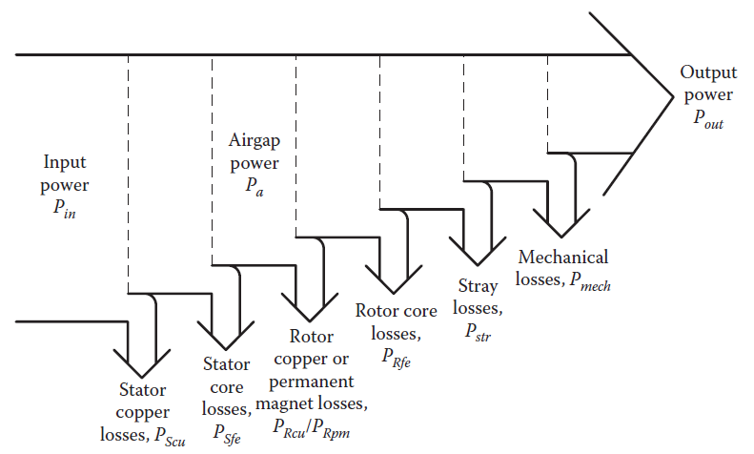
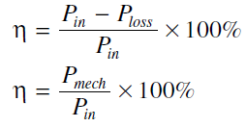
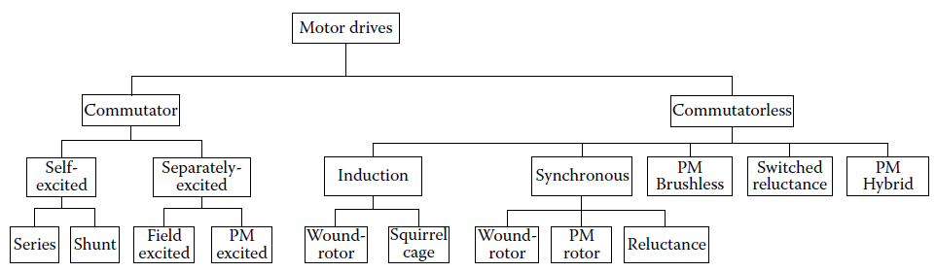
Fig. 1. General loss distribution diagram in electric machines for motoring mode of operation.
Fig. 2. Classification of EMs drives for EV and HEV applications.

Slide 4
Electric propulsion systems consist of:
Electric Motors (EMs);
Power converters;
Electronic controllers.
The EM converts the electric energy into mechanical energy to propel the vehicle or vice versa, to enable regenerative braking and/or to generate electricity for the purpose of charging the on-board energy storage.
The power converter is used to supply the EM with proper voltage and current;
The electronic controller commands the power converter by providing control signals to it, and then controls the operation of the EM to produce proper torque and speed, according to the command from the driver. The electronic controller can be further divided into three functional units—sensor, interface circuitry, and processor. The sensor is used to translate the measurable quantities, such as current, voltage, temperature, speed, torque, and flux, into electric signals through the interface circuitry. These signals are conditioned to the appropriate level before being fed into the processor. The processor output signals are usually amplified via the interface circuitry to drive power semiconductor devices of the power converter.

Slide 5
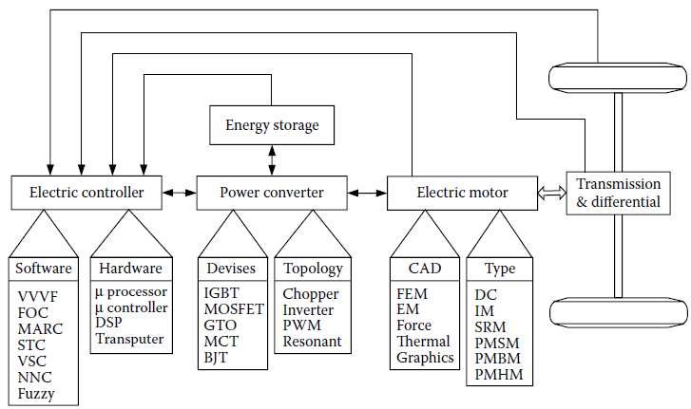
Fig. 3. Functional block diagram of a typical electric propulsion system.

Slide 6
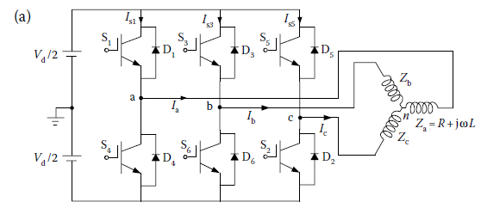
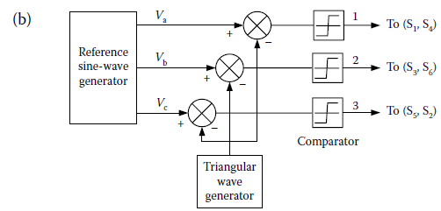
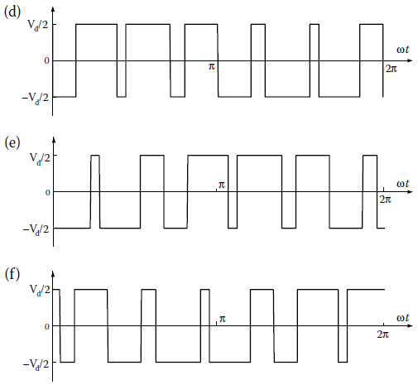
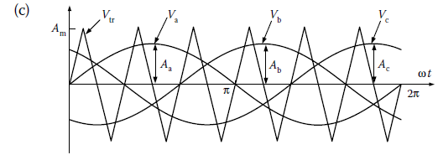
Fig. 4. DC/AC inverter with sinusoidal pulse-width modulation: (a) inverter topology; (b) control signals; (c) three phase reference voltage and triangular carrier waveforms; (d) voltage of phase a; (e) voltage of phase b; and (f) voltage of phase c.

Slide 7
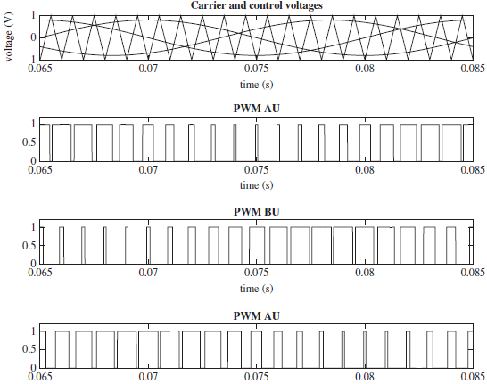
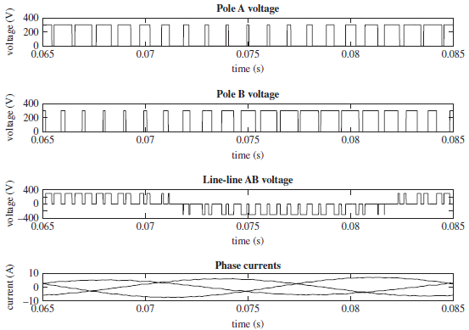
Fig. 5. More detail of Three-phase sinusoidal PWM patter with line-line voltage presentation.

Slide 8
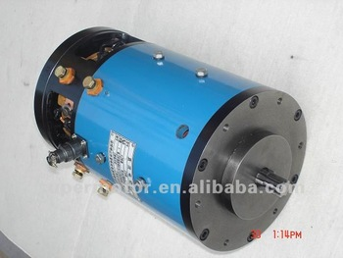
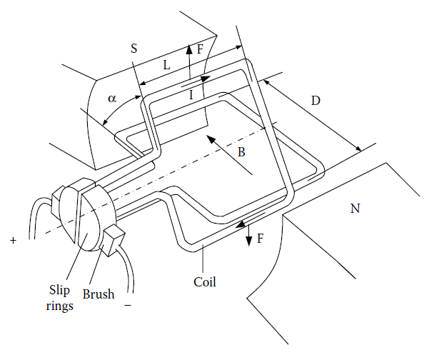
3.2. Brushed DC motor
Brushed DC motors have permanent magnets (PM) to make the stator; rotors have brushes to feed current into the armature and to provide supply and to the stator.
Brushed DC motors merits are:
ability to provide maximum torque in low speed;
Simple control.
Brushed DC motors limitations are:
bulky structure and low power density;
low efficiency;
heat generated because of the brushes and associated drop in efficiency (The heat is also difficult to remove as it is generated in the center of the rotor);
Requirement to commutators and brushes, thus making them less reliable and unsuitable for maintenance-free operation and high speed.
Because of limitations, brushed DC motors are not used in EVs any more.
Fig. 6. Operation principle of a DC motor.

Slide 9
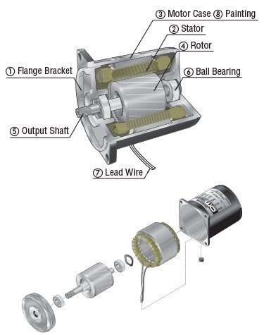
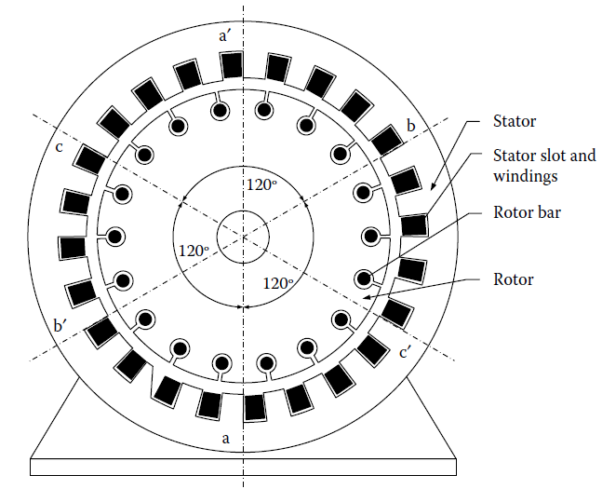
3.3. Induction Motor (IM)
IMs are used in early EVs like GM-EV1 as well as current models like the Tesla and is the most mature commutatorless motors for EV and HEV propulsion due to advantages as:
low cost,
high reliability,
maintenance-free operation.
Fig. 7. An IM structure: Cross section(left), and 3D internal parts (right).

Slide 10
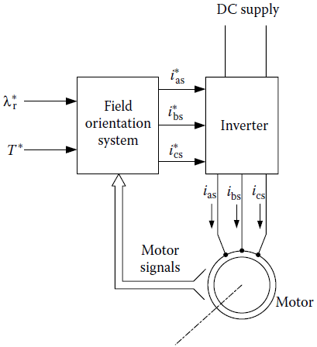
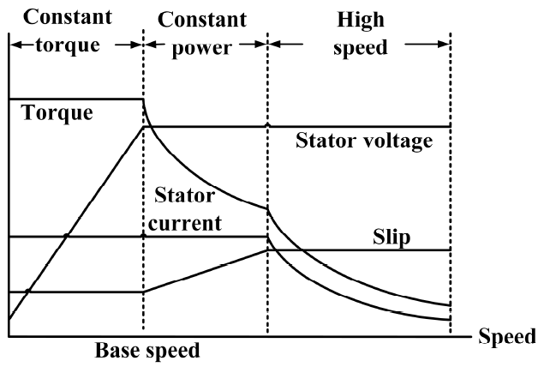
Vector control is useful to make IM drives capable of meeting the needs of EV systems.
Field Orientation Control (FOC) can make an IM act like a separately excited DC motor by decoupling its field control and torque control (can achieve a range three to five times the base speed with an IM that is properly designed). However, these EV and HEV motors using FOC still suffer from low efficiency at light loads and limited constant-power operating range.
Flux weakening can extend the speed range over the base speed while keeping the power constant.
Three phase, four pole IM with copper rotors are seen to be employed in current EVs.
Fig. 9. General block diagram of a vector control system for an IM.
Fig. 8. An IM drive characteristics. Maximum torque is maintained till base speed, and then decreases exponentially.

Slide 11
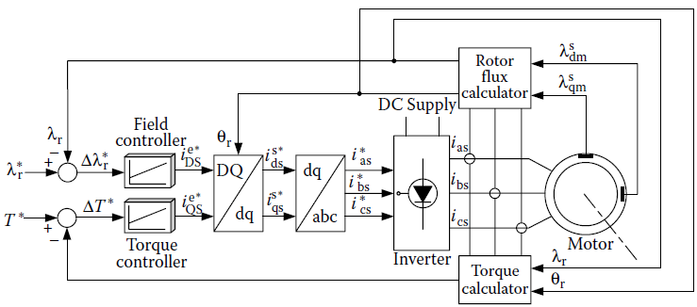
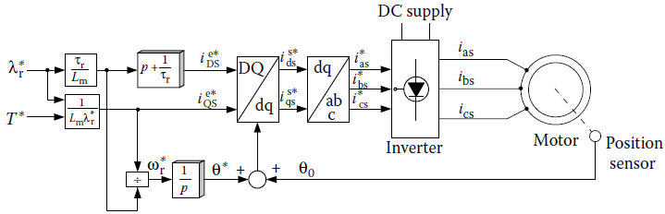
Fig. 10. Vector control system for an IM with direct rotor flux orientation.
Fig. 11. Vector control system for an IM with indirect rotor flux orientation.

Slide 12
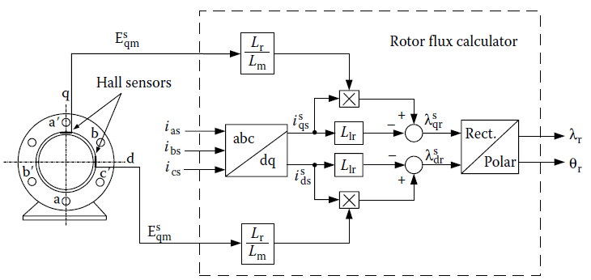
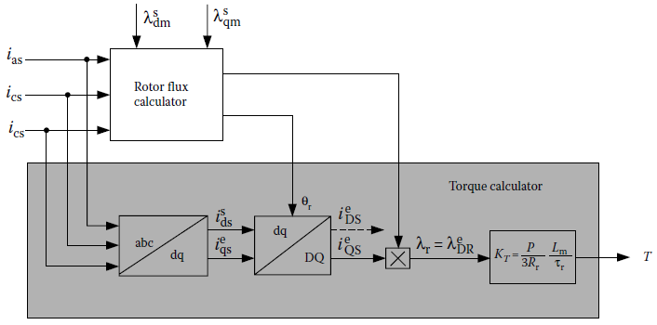
Fig. 12. Vector control system for an IM with direct rotor flux orientation.
Fig. 13. Vector control system for an induction motor with indirect rotor flux orientation.

Slide 13
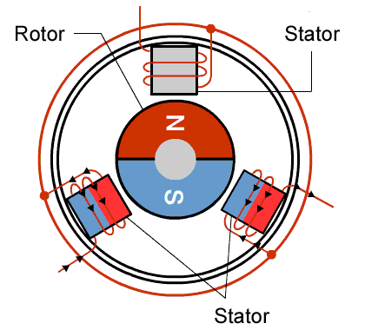
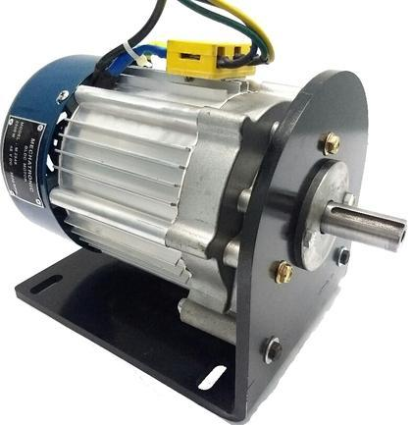
3.4. Permanent Magnet Brushless DC motor (BLDC)
The rotor of BLDC motor is made of PM (most commonly NdFeB), and the stator is provided an alternating current (AC) supply from a DC source through an inverter.
By virtually inverting the stator and rotor of PM DC motors (commutator), PM brushless DC (BLDC) motors are generated. It should be noted that the term “DC” may be misleading, since it does not refer to a DC current motor. Actually, these motors are fed by rectangular AC current and hence are also rectangular-fed PM brushless motors.
There are three classes of PMs currently used for electric motors:
Alnicos (Al, Ni, Co, Fe);
Ceramics (ferrites), for example, barium ferrite (BaO × 6Fe2O3) and strontium ferrite (SrO × 6Fe2O3);
Rare-earth materials, that is, samarium–cobalt (SmCo), and neodymium–iron–boron (NdFeB).
Fig. 14. A BLDC structure: Cross section(left), and a real sample (right).

Slide 14
BLDC merits comparing induction motors are:
high efficiency: because of no rotor copper loss (there are no windings in the rotor and use of PMs for the excitation, which consume no power); The absence of mechanical commutator and brushes means low mechanical friction losses and therefore higher efficiency.
Light, smaller and compactness: The recent introduction of high-energy density magnets (rare-earth magnets) has allowed achieving very high flux densities in the BLDC motor. This allows achieving accordingly high torques (more torque density and specific power), which in turns allows making the motor small and light.
Ease of control: can be controlled as easily as a DC motor because the control variables are easily accessible and constant throughout the operation of the motor.
Ease of heat dissipating and cooling: There is no current circulation in the rotor. Therefore, the rotor of a BLDC motor does not heat up. The only heat production is on the stator, which is easier to cool than the rotor because it is static and on the periphery of the motor.
Low maintenance, great longevity, and reliability: The absence of brushes and mechanical commutators suppresses the need for associated regular maintenance and suppresses the risk of failure associated with these elements. The longevity is therefore only a function of the winding insulation, bearings, and magnet life-length.
Low noise emissions: There is no noise associated with the commutation because it is electronic and not mechanical. The driving converter switching frequency is high enough so that the harmonics are not audible.

Slide 15
BLDC limitations comparing induction motors are:
Limited constant power range because of restrained field-weakening ability: A large constant power range is crucial to achieving high vehicle efficiencies. The PM BLDC motor is incapable of achieving a maximum speed greater than twice the base speed. Indeed BLDC suffers from torque reduction vs. speed increasing because of back EMF generated in the stator windings;
High cost due to use of PM: Rare-earth magnets are much more expensive than other magnets and result in an increased motor cost;
relative low speed ratio to meet the needs of EV use, specifically in off-roaders. The surface-mounted PM motors cannot reach high speeds because of the limited mechanical strength of the assembly between the rotor yoke and the PMs.
Magnet demagnetization: Magnets can be demagnetized by large opposing magnetomotive forces and high temperatures. The critical demagnetization force is different for each magnet material. Great care must be brought to cooling the motor, especially if it is built compact.
Inverter failures in BLDC motor drives: Because of the PMs on the rotor, BLDC motors present major risks in the case of short-circuit failures of the inverter.
Safety: Large rare-earth PMs are dangerous during the construction of the motor because flying metallic objects are attracted towards them. There is also a danger in the case of vehicle wreck if the wheel is spinning freely: the motor is still excited by its magnets and high voltage is present at the motor terminals that can possibly endanger the passengers or rescuers.

Slide 16
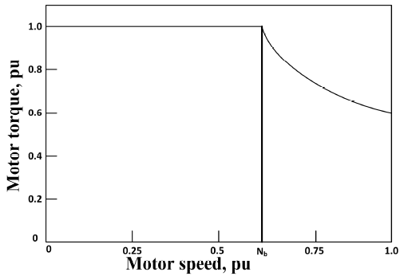
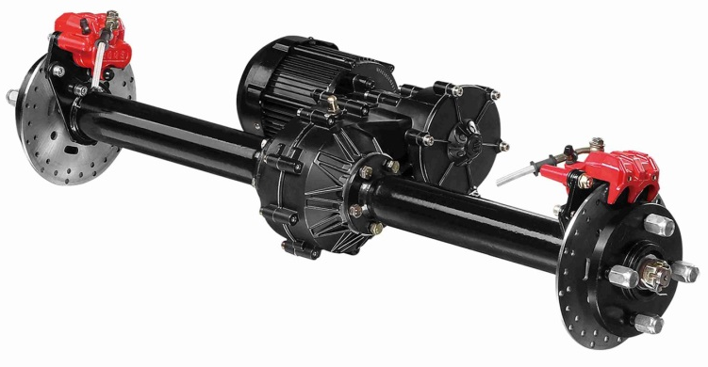
Speed range and efficiency enhancement in BLDC motors are possible with:
additional field windings. Such arrangements are dubbed PM hybrid motors because of the presence of both PM and field windings (high complexity of structure). PM hybrid motors can also be constructed using a combination of reluctance motor and PM motor.
controlling the conduction angle of the power converter, reaching as high as four times the base speed (though the efficiency may decrease at very high speed resulting from demagnetization of PM).
Other than the PM hybrid configurations, PM BLDCs can be buried magnet mounted—which can provide more air gap flux density, or surface magnet mounted—which require less amount of magnet.
BLDCs are useful for use in small cars requiring a maximum 60 kW of power.
Fig. 15. Characteristics of a PM BLDC Motor. The torque remains constant at the maximum right from the start, but starts to decrease exponentially for speeds over the base speed.

Slide 17
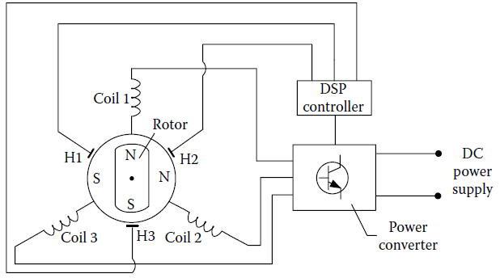
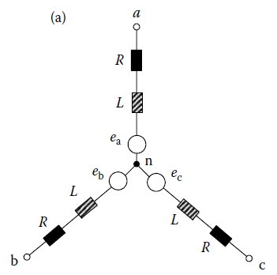
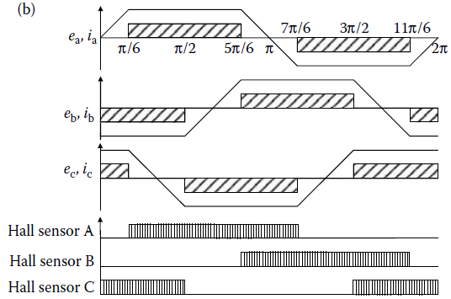
Fig. 16. General block diagram of a control system for an BLDC motor.
Fig. 17. (a) Three-phase equivalent circuit and (b) back EMFs, currents, and Hall sensor signals of a BLDC motor.

Slide 18
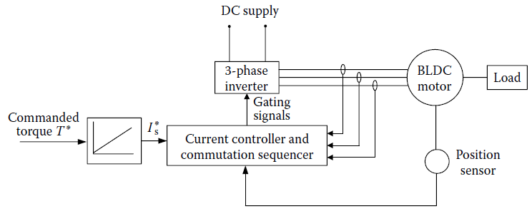
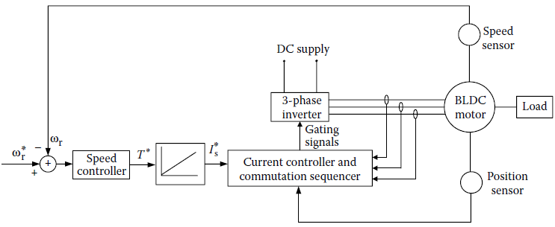
Fig. 18. Block diagram of the torque (above) and speed (beyond) control of the BLDC motor.

Slide 19
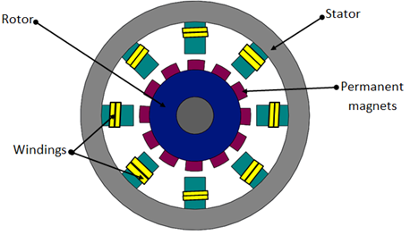
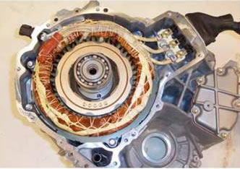
3.5. Permanent Magnet Synchronous Motor (PMSM)
PMSMs are often referred to as brushless AC (BLAC) (sinusoidal back EMF) machines and include surface permanent magnet (SPM) and interior permanent magnet (IPM) machines. NdFeB PMs are used for PMSMs for high energy density.
The flux linkages in the air-gap are sinusoidal in nature; therefore, these motors are controllable by sinusoidal voltage supplies and vector control and Control of BLAC machines will then be extended into synchronous reluctance and finally IM control.
Fig. 19. A BLAC structure: Cross section(left), and a real sample (right).

Slide 20
PMSM is the most used motor in the BEVs available currently (at least 26 vehicle models use this motor technology) due to merits such as:
capable of being operated at a range of speeds without the need of any gear system (makes these motors more efficient and compact);
very suitable for in-wheel applications;
capable of providing high torque, even at very low speeds.
Can be construct without the need of bearings for the rotor due to outer rotor.
Operates at a higher power factor compared to the induction motor due to the absence of magnetizing current.
Does not require regular brush maintenance such as conventional wound-rotor synchronous machines.
The rotor does not require any supply and rotor losses are very low.
Low noise and vibration than switched reluctance and induction machines.
Lower rotor inertia and hence fast response.
Larger energy density and compact structure.
PMSM only limitation comes in during in-wheel operations:
huge iron loss is faced at high speeds, making the system unstable;
high cost of the PMs and its sensitivity to temperature and load conditions.

Slide 21
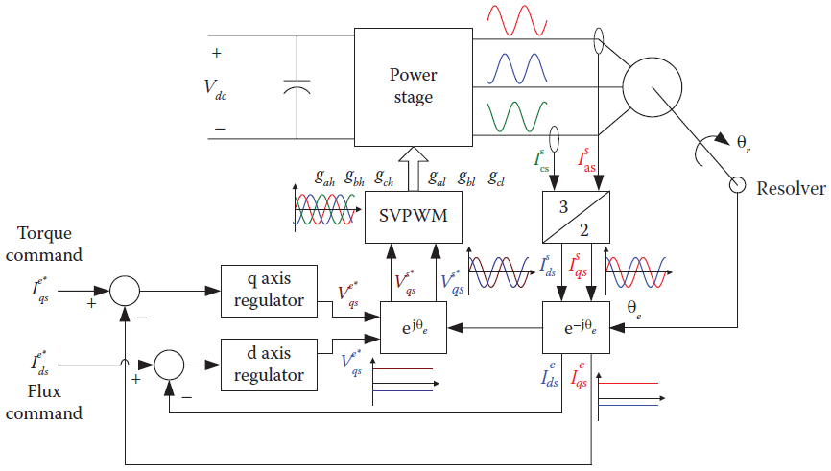
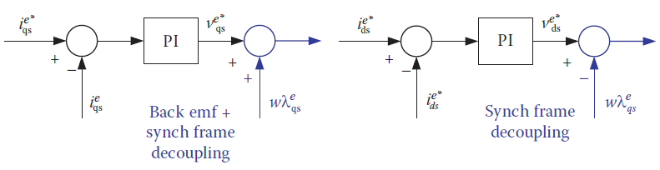
Fig. 20. Block diagram of PM AC machine controller with transformations.
Fig. 21. Reference frame and back EMF decoupling in AC synchronous frame controllers.

Slide 22
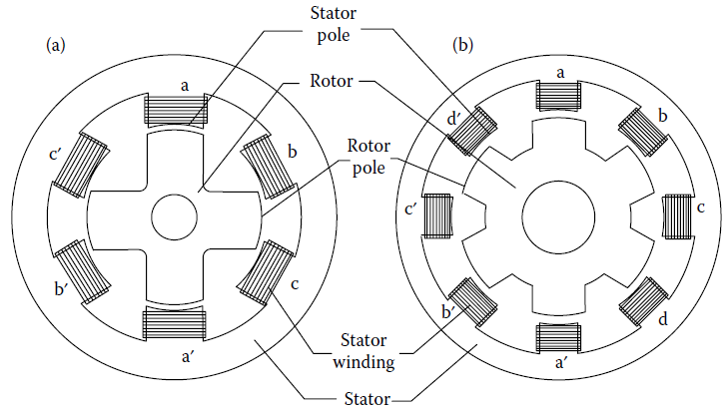
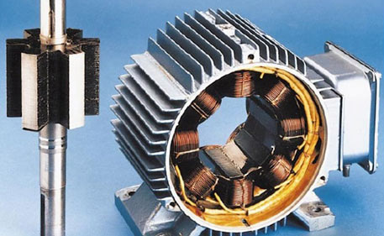
3.6. Switched Reluctance Motor (SRM)
SRMs or doubly salient motors (because of having salient poles both in the stator and the rotor) are synchronous motors driven by unipolar inverter-generated current. SRMs have been recognized to have considerable potential for EV and HEV applications. Basically, they are direct derivatives of single-stack variable-reluctance stepping motors.
Traditionally, SRMs operate with shaft sensors to detect the relative position of the rotor to the stator. These sensors are usually vulnerable to mechanical shock and sensitive to temperature and dust. Therefore, the presence of the position sensor reduces the reliability of SRMs and constrains some applications.
Fig. 22. Cross section of common SRM configurations: (a) a 6/4 SRM and (b) an 8/6 SRM.

Slide 23
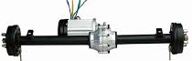
SRM merits that are useful for EV applications are:
simple and robust mechanical construction;
low cost;
high-speed;
less chance of hazards;
inherent long constant power range and outstanding torque–speed characteristics for EV and HEV applications;
high power density.
PM is not required that increase reliability along with fault tolerance
SRM limitations that cause less advance comparing to PMs or IMs (However, because of the high cost rare earth materials needed in PM machines, interest in SRMs are increasing) are:
very noisy because of the variable torque nature;
low efficiency;
larger in size and weight compared to PM machines.
Though have a simple construction, their design and control are not easy resulting from fringe effect of slots and poles and high saturation of the pole-tips.
Reducing the noise and torque ripple are the main concerns in researches associated with SRMs. A dual stator system, can provide low inertia and noise, superior torque density and increased speed-range compared to conventional SRMs.
Design by finite element analysis can be employed to reduce the total loss.
Control by fuzzy sliding mode can also be employed to reduce control chattering and motor nonlinearity management.

Slide 24
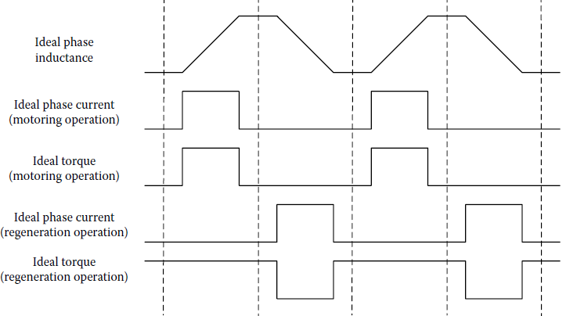
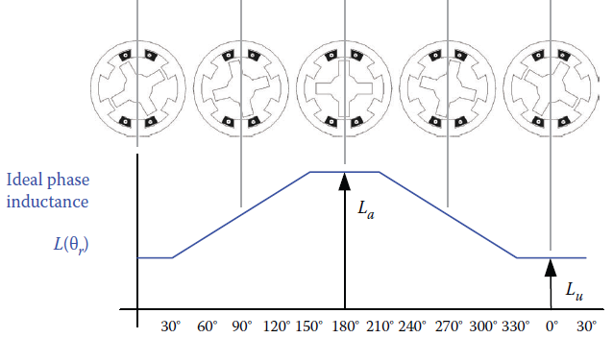
Fig. 23. Idealized inductance, current, and torque profiles of the SRM.
Fig. 24. Plot of an idealized phase inductance versus rotor position in a 6/4 SRM.

Slide 25
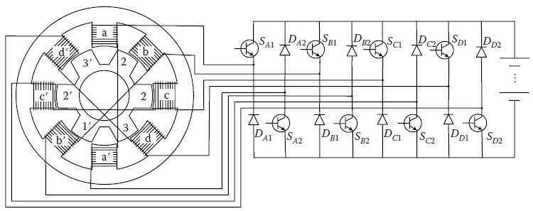
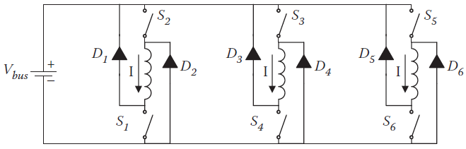
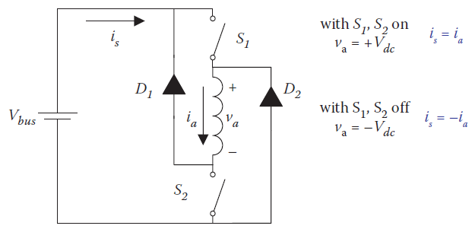
Fig. 25. SRM and its power supply.
Fig. 26. Operation of one phase of an SRM drive.
Fig. 27. A standard drive topology of a three-phase SRM.

Slide 26
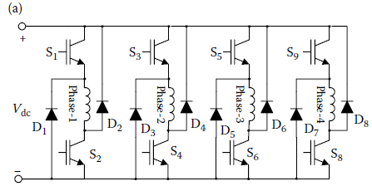
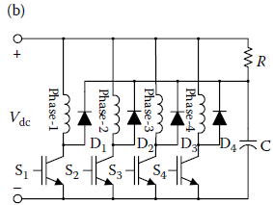
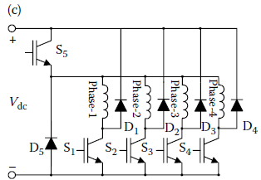
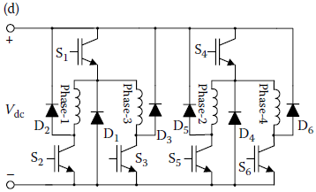
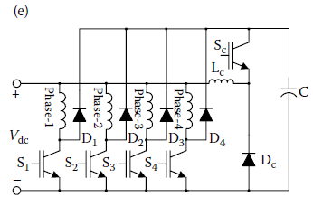
Fig. 28. Different inverter topologies for SRM drives: (a) classic half-bridge converter; (b) R-dump; (c) n + 1 switches (Miller converter); (d) 1.5n switch converter; and (e) C-dump.

Slide 27
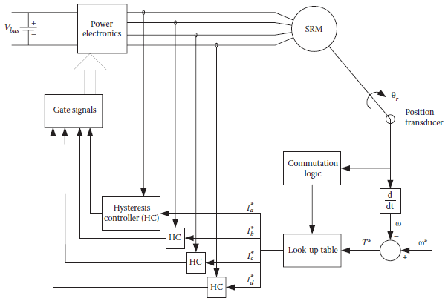


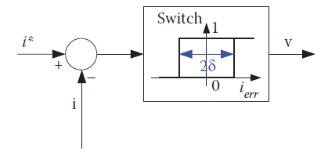
Fig. 29. High-level block diagram of a four-phase SRM controller.
Fig. 30. Hysteresis Controller (HC) function and block diagram.
SRMs have a significant advantage over PMs and IMs in that there are no magnets or windings on the rotor. The structure of the SRM is extremely robust. It is constructed of stacked laminations for both the stator and rotor and works on the principle of the reluctance force that attempts to align the magnetic pole of the rotor to the stator when the stator is energized.

Slide 28



3.7. Synchronous Reluctance Motor (SynRM)
A SynRM runs at a synchronous speed while combining the merits of both PM and induction motors as:
robust and fault tolerant like an IM;
efficient and small like a PM motor;
do not have the drawbacks of PM systems;
Have a control strategy similar to that of PM motors.
The main limitations of SynRMs, which hinder its use in EVs are as:
Problems associated with controllability;
Manufacturing;
low power factor.
One way to improve SynRMs is by increasing the saliency which provides a higher power factor. It can be achieved by axially or transversally laminated rotor structures.
Fig. 31. SynRM with axially laminated rotor in two viewpoint.

Slide 29


3.8. PM-Assisted SynRM
a PM-assisted SynRM can be achieved from SynRMs by integrating some PMs in the rotor, and has this merits:
Greater power factor and relative high power density;
Though it is similar to an IPM, the PMs used are fewer in amount and the flux linkages from them are less too.
PMs added in the right amount to the core of the rotor increase the efficiency with negligible back EMF and little change to the stator.
With a proper efficiency optimization, have the performance similar to IPM motors.
This concept is free from the problems associated with demagnetization resulting from overloading and high temperature observed in IPMs.
A PM-assisted SynRM, suitable for EV, use was demonstrated by BRUSA Elektronik AG.
Fig. 32. Cross section of PM-assisted SysRM
(Permanent magnets are embedded in the rotor).

Slide 30


3.9. Axial Flux Ironless PM Motor
Axial Flux Ironless PM Motor is the one of the most advanced motor to be used in EVs, with this merits:
has an outer rotor with no slot (improves the efficiency by minimizing copper loss as there is more space available); use of iron is avoided here as well;
The stator core is absent too, reducing the weight of the machine;
The air gap here is radial field type, providing better power density;
is a variable speed motor;
rotors can be fitted on lateral sides of wheels, placing the stator windings on the axle centrally;
Table 1. Power comparison of different motors having the same size.
Table 2. Typical torque density values of some motors.

Slide 31

Table 3. Advantages, disadvantages and usage of different EM types and their usage cases. Con.

Slide 32

Table 3. Advantages, disadvantages and usage of different EM types and their usage cases.

