Slide 1
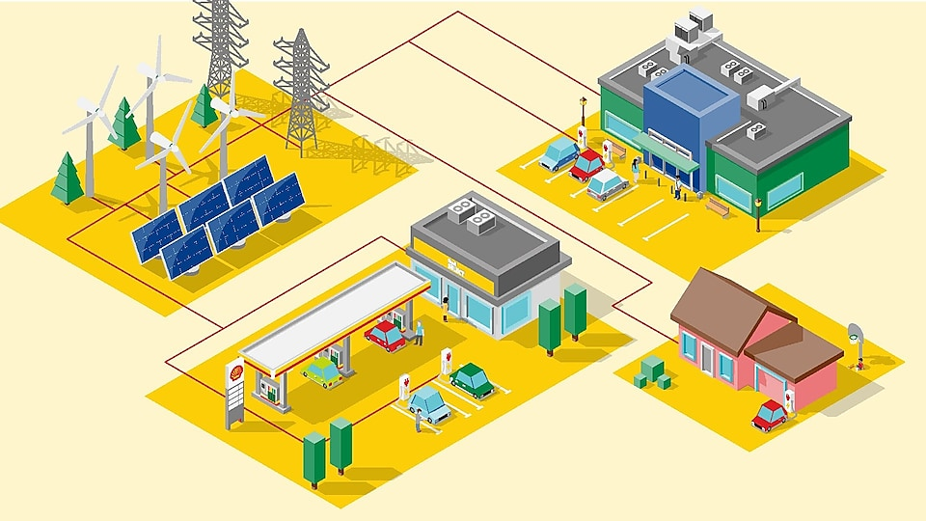
Chapter 5:
Investigation on EV Development Dimensions: Impacts on Our World, Barriers on Development and Their Solutions, and Market

Slide 2
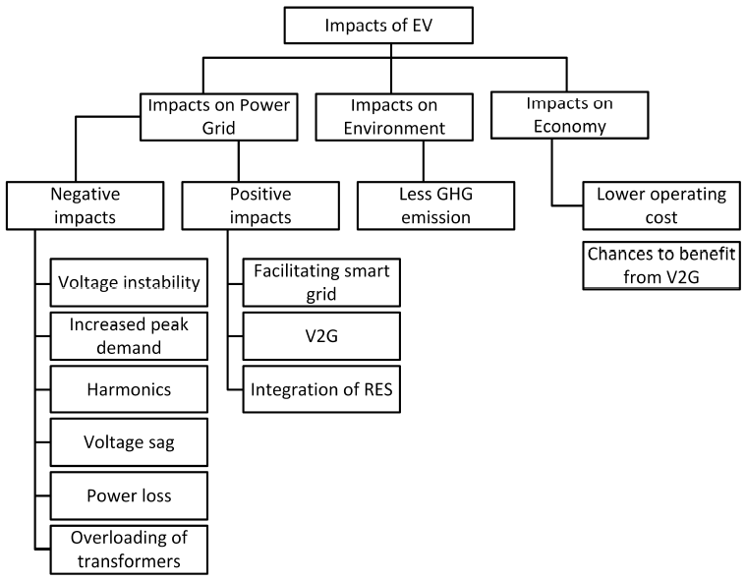
5.1. EV Impacts on our world
Fig. 1. A short list of the impacts of EVs on the power grid, environment and economy.

Slide 3
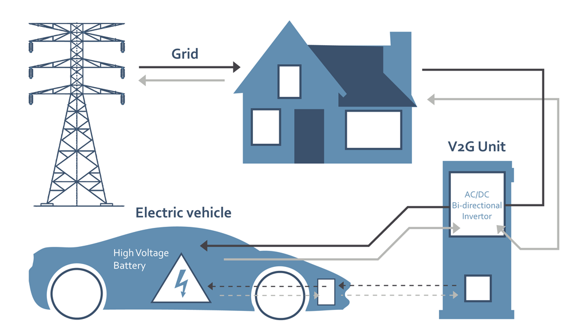
5.1.1. Impacts on power grid
EVs are relatively high power loads and they affect the power distribution system directly (distribution transformers, cables and fuses are affected by it the most).
A Nissan Leaf with a 24 kWh battery pack consume power similar to a single European household.
A 3.3 kW charger, in a 220 V and 15 A system, can raise the current demand by 17% to 25%.
Addition of EV load in peak hours can cause load unbalance, shortage of energy, instability, and decrease in reliability and degradation of power quality (specially more than level 1). It causes to increase the infrastructure costs.
Charging without any concern to the time of drawing power from the grid is denoted as uncoordinated charging, uncontrolled charging or dumb charging.
Reducing the charging time to distinguish vehicles in the EV market, requires higher voltages. Therefore, mitigating the adverse effects is not likely by employing low charging voltages.

Slide 4
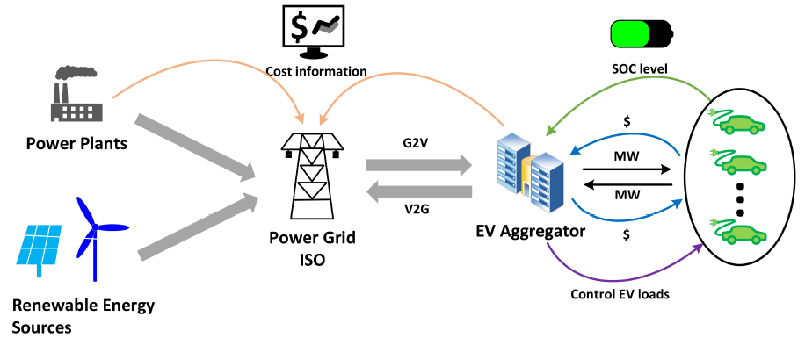
To avoid the negative effects, and to provide efficient charging with the available infrastructure, coordinated charging (also called controlled or smart charging) has to be adopted (EVs are charged during the time periods when the demand is low, for example, after midnight). It needs only a few upgrades in the infrastructure.
It not only prevents addition of extra load during peak hours, but also increases the load in valley areas of the load curve, facilitating proper use of power plants with better efficiency.
On the consumer side, the electricity bill can be reduced as the electricity is consumed by the EVs during off peak hours, which generally have a cheaper rate than peak hours.
smart charging systems can reduce the increased investment cost in distribution system by 60–70%.
Fig. 2. Conceptual presentation of the power supply system for EVs.

Slide 5
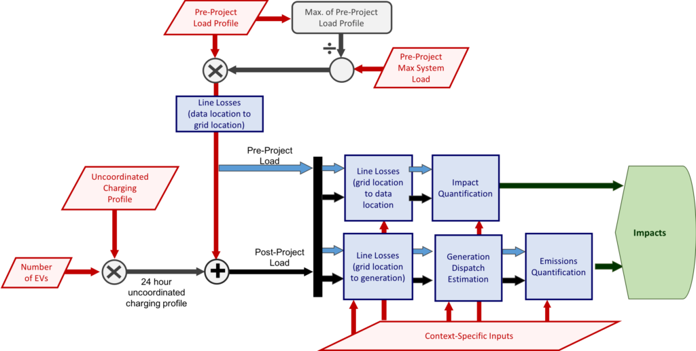
(a)
Fig. 3. Block diagram of the uncoordinated and coordinated charging system for EVs:
a) uncoordinated; b) coordinated.

Slide 6
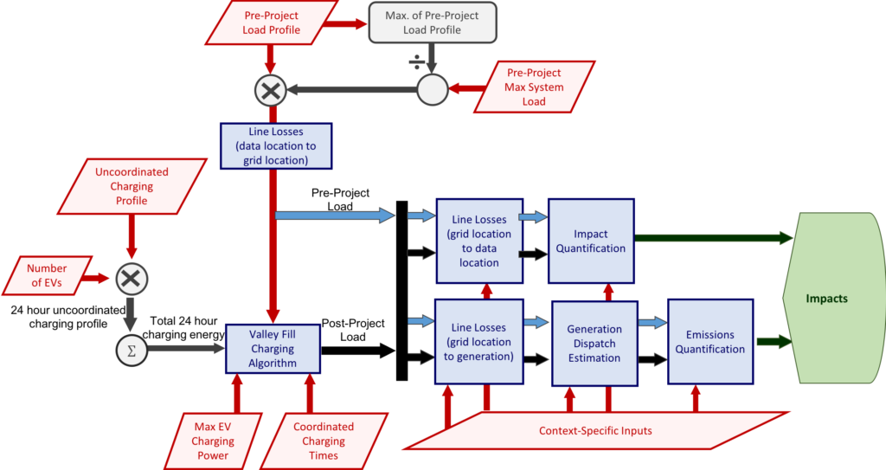
(b)
Fig. 4. Block diagram of the uncoordinated and coordinated charging system for EVs:
a) uncoordinated; b) coordinated.

Slide 7
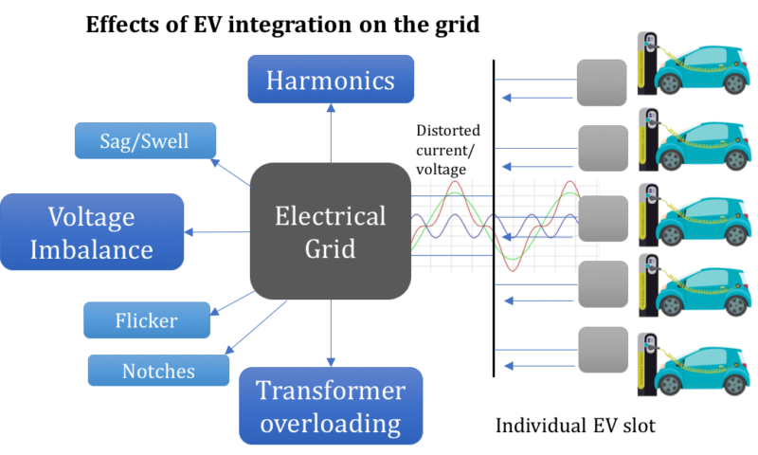
The major problems that are faced in the power systems because of EVs can be charted as follows:
Voltage instability: can occur because of load characteristics, and that instability can lead to blackouts. EV loads have nonlinear characteristics, which are different than the general industrial or domestic loads, and draw large quantities power in a short time period (unpredictable). If the EVs have constant impedance load characteristics, then it is possible for the grid to support a lot of vehicles without facing any instability. To anticipate these loads properly, appropriate modeling methods and control systems like fuzzy logic controllers are required to calculate voltages and SOCs of batteries.
Fig. 5. EV utilizing effects on the power grid.

Slide 8
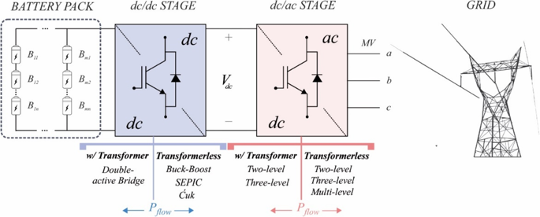
Harmonics: The EV chargers are nonlinear, gives raise high frequency components of current and voltage, known as harmonics. Harmonics reduce the power quality and causes stress in the power system equipment like cables and fuses. The present cabling is capable of withstanding 25% EV penetration if slow charging is used, in case of rapid charging, the amount comes down to 15%. the modern EVs generate less THD_{i} than the conventional ones, though their THD_{v} are higher. Three ways to reduce harmonics:
with increased number of EVs, there are chances of harmonics cancellation because of different load patterns (Different EV chargers can produce different phase angles and magnitudes which can lead to such cancellations).
Even eliminate harmonics is reduced by applying PWM in the EV chargers.
High THD_{i} can be avoided by using filtering equipment at the supply system.
Fig. 6. Conceptual presentation of interaction between an Charging infrastructure and grid.

Slide 9
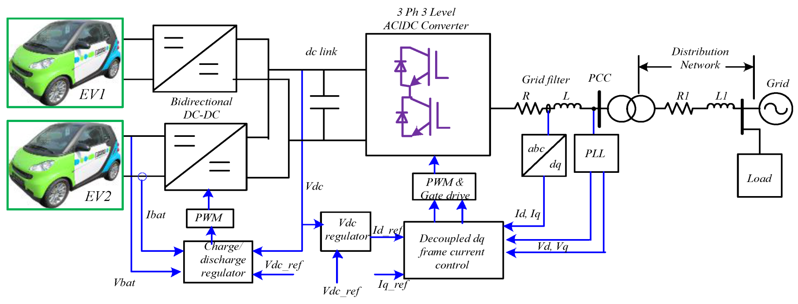
Voltage sag: A decrease in the RMS value of voltage for half a cycle or 1 min is denoted as voltage sag. It can be caused by overload or during the starting of electric machines. 20% EV penetration can exceed the voltage sag limit. 60% EV penetration is possible without any negative impact is possible if controlled charging is employed. Considerable decrease in voltage sag is achieved with application of voltage droop charging. Application of smart grid can help in great extents in mitigating the sag.
Power loss: The extra loss of power caused by EV charging is PL_{EV}-PL_{original}. PL_{original} is the loss occurred when the EVs are not connected to the grid and PL_{EV} is the loss with EVs connected. The power loss is increased as high as 40% in off peak hours considering 60% of the UK PEVs to be connected to distribution system. Uncoordinated charging, therefore, can increase the amount of loss furthermore. Power generated in the near vicinity and also distributed generation can help minimizing the losses, to charge the vehicles near the local power plant.
Fig. 7. Conceptual presentation of the complete charging rout from grid to the vehicles.

Slide 10
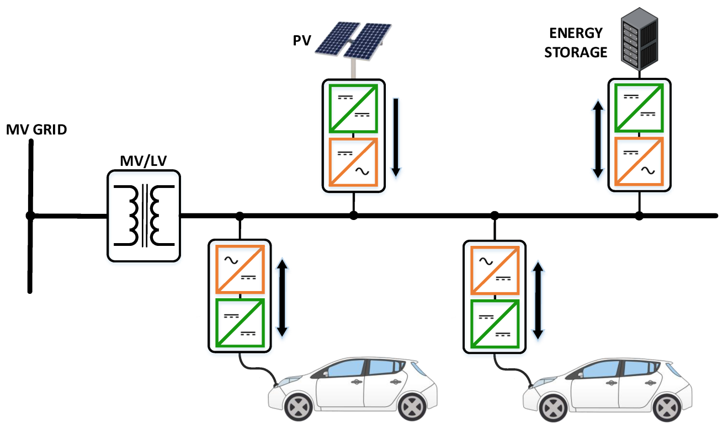
Transformers overloading: The extra heat generated by EV loads can lead to increased aging rate of the transformers, but it also depends on the ambient temperature. it Is negligible in cold weather. Factors taken into account for estimation of the lifetime of a transformer are the rate of EV penetration, starting time of charging and the ambient temperature. It stated that transformers can withstand 10% EV penetration without getting any decrease in lifetime. The effect of level 1 charging (until 20%), is in fact, has negligible effect on this lifetime, but significant increase in level 2 charging (10% EV penetration) can lead to the failure of transformers. Charging that takes place right after an EV being plugged in can be detrimental to the transformers.
Power quality degradation: The increased amount of harmonics and imbalance in voltage will degrade the power quality in case of massive scale EV penetration to grid.
Fig. 8. Power utilizing from the grid by EVs.

Slide 11
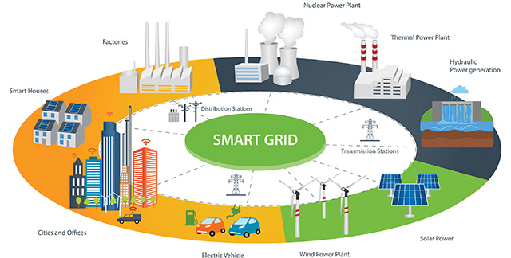
On the plus side, EVs has the positive impacts on the power systems as follows:
Smart grid: In the smart grid system, intelligent communication and decision making is incorporated with the grid architecture. Smart grid is highly regarded as the future of power grids and have advantages of reliable power supply and advanced control. In such a system, the much coordinated charging is easily achievable as interaction with the grid system becomes very much convenient even from the user end. The interaction of EVs and smart grid can facilitate opportunities like V2G and better integration of renewable energy. In fact, EV is one the eight priorities listed to create a smart grid.
V2G applications: V2G is a method where the EV can provide power to the grid. In this system, the vehicles act as loads when they are drawing energy, and then can become dynamic energy storages by feeding back the energy to the grid. In coordinated charging, the EV loads are applied in the valley points of the load curve, in V2G; EVs can act as the power sources to provide during peak hours. V2G is realizable with the smart grid system and EVs can be used as dynamic loads or dynamic storage systems.
Fig. 9. Simple presentation of the smart grid beside the EVs.

Slide 12
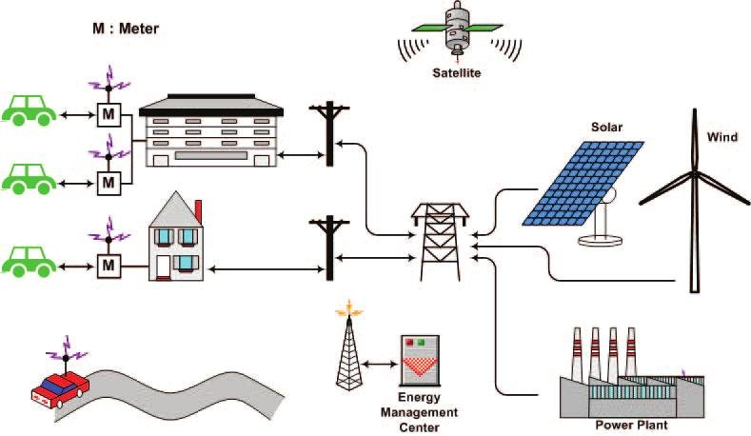
The V2G power flow in the smart grid systems can be:
I. Unidirectional system: is analogous to the coordinated charging scheme; the vehicles are charged when the load is low, but the time to charge the vehicles is decided automatically by the system. Vehicles using this scheme can simply be plugged in anytime and put there; the system will choose a suitable time and charge it. Smart meters are required for enabling this system. With a driver variable charging scheme, the peak power demand can be reduced by 56%. This system particularly attractive as it required little upgradation of the existing infrastructure; creating a communication system in-between the grid and the EVs is all that is needed.
Fig. 10. Conceptual presentation of V2G system.

Slide 13
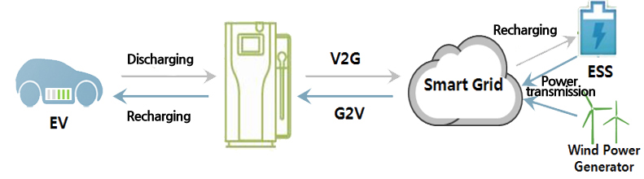
II. Bidirectional system: allows vehicles to provide power back to the grid. In this scenario, vehicles using this scheme will supply energy to the grid from their storage when it is required. This method has several appealing aspects. EVs have energy storages, and in many cases, they are not used for a long time (the cars in the parking lots of an office block, which stay unused till office hour is over, vehicles stay parked 95% of the time). These potential storages can be used when there is excess generation or low demand and when the energy is needed, it is taken back to the grid. The vehicle owners can also get economical benefit by selling this energy to the grid. Bidirectional charging, needs:
chargers capable of providing power flow in both directions;
Smart meters to keep track of the units consumed and sold, and advanced metering Infrastructure (AMI) to learn about the unit charges in real time to get actual cost associated with the charging or discharging at the exact time of the day. The AMI system can shift 54% of the demand to off-peak periods, and can reduce peak consumption by 36%.
Fig. 11. Conceptual presentation of the bidirectional V2G system and smart grid.

Slide 14
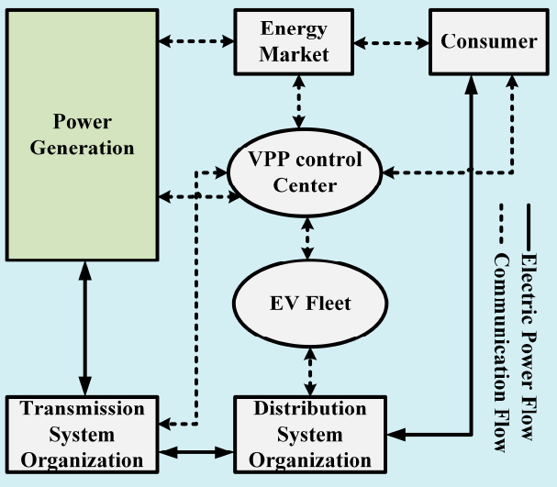
The bidirectional system, in fact, can provide 12.3% more annual revenue than the unidirectional one. But taking the metering and protections systems required in the bidirectional method, this revenue is nullified and indicates the unidirectional system is more practical. Frequent charging and discharging caused by bidirectional charging can also reduce battery life and increase energy losses from the conversion processes.
In a V2G scenario, operators with a vehicle fleet are likely to reduce their cost of operation by 26.5%.
Another concept that is produced using the smart grid and the EVs, called Virtual Power Plant (VPP), where a cluster of vehicles is considered as a power plant and dealt like one in the system.
Fig. 12. VPP architecture and control.

Slide 15
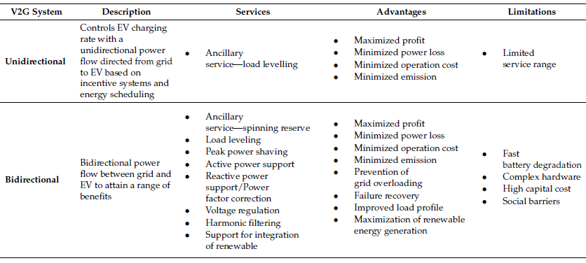
Table 1. Unidirectional and bidirectional V2G characteristics..
Integration of Renewable Energy Sources (RES): Renewable energy usage becomes more promising with EVs integrated into the other power sources. EV owners can use RES to generate power locally to charge their EVs. For example:
Parking roofs have high potential for the placement of PV panels which can charge the vehicles parked underneath as well as supplying the grid in case of excess generation.

Slide 16
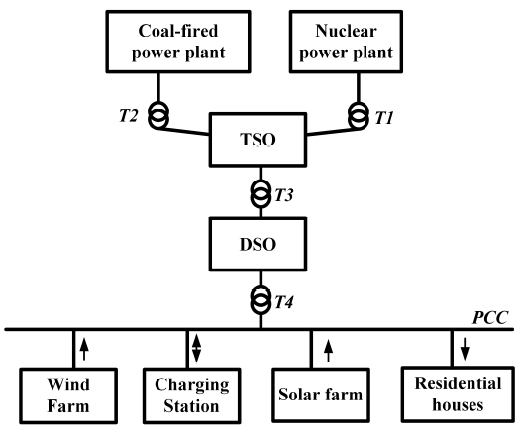
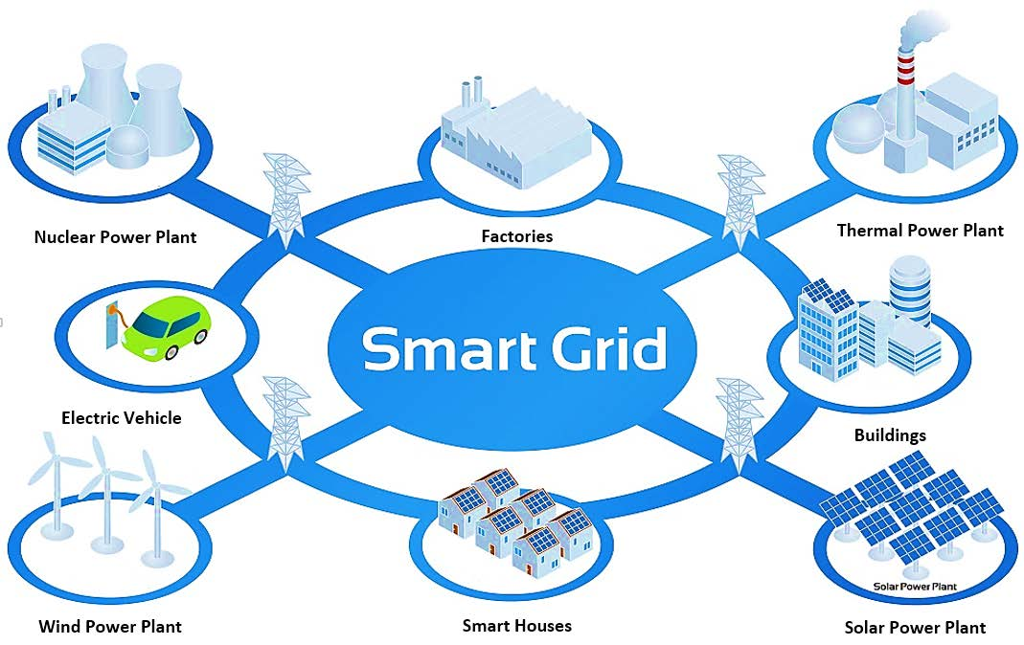
The V2G structure is further helpful to integrate RES for charging of EVs, and to the grid as well, as it enables the selling of energy to the grid when there is surplus, for example, when vehicles are parked and the system knows the user will not need the vehicle before a certain time. V2G can also enable increased penetration of wind energy (41%–59%) in the grid in an isolated system.
Fig. 13. Wind and solar integration in the grid with the help of EV in V2G system. TSO: Transmission System Organization; DSO: Distribution System Organization; T1 to T4 represent the transformers coupling the generation, transmission, and distribution stages.

Slide 17
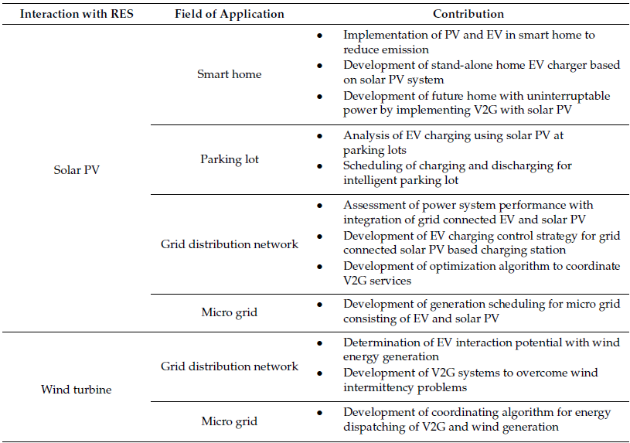
Table 2. Scopes of assisting Renewable Energy Source (RES) integration using EV. Con.

Slide 18
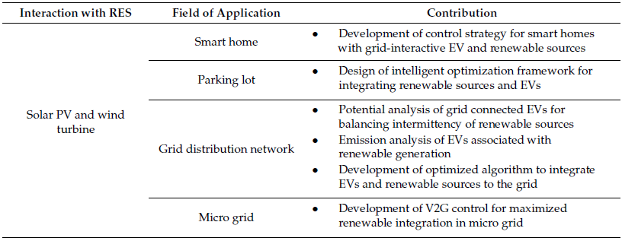
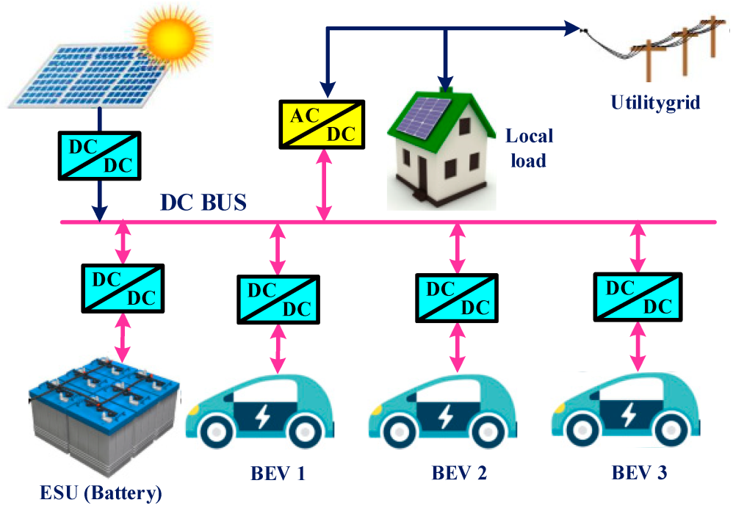
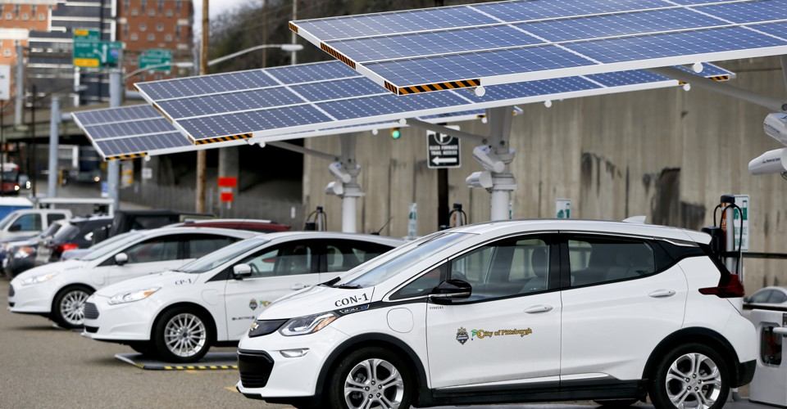
Table 3. Scopes of assisting RES integration using EV.

Slide 19
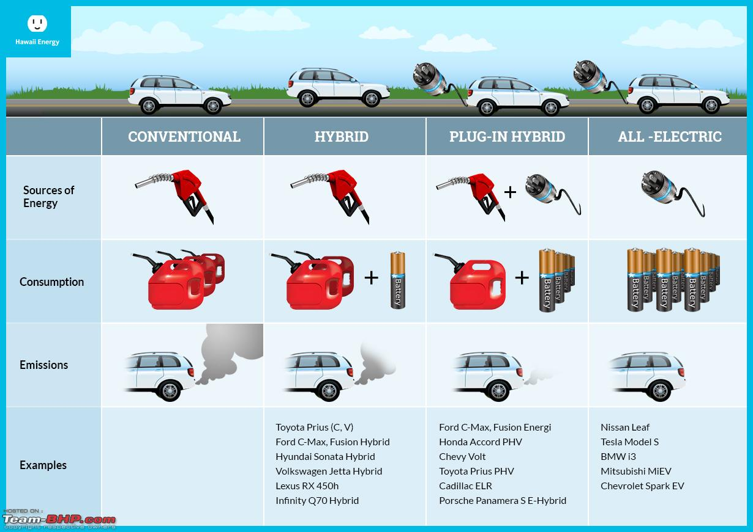
5.1.2 Impacts on environment
GHG emission reduction One of the main factors that propelled the increase of EVs popularity is their contribution to reduce the GHG emissions. Conventional ICE vehicles burn fuels directly and thus produce harmful gases, including CO₂ and CO. Though HEVs and PHEVs have IC engines, their emissions are less than the conventional vehicles.
Fig. 14. A General comparison among various types of vehicles in pollution mass.

Slide 20
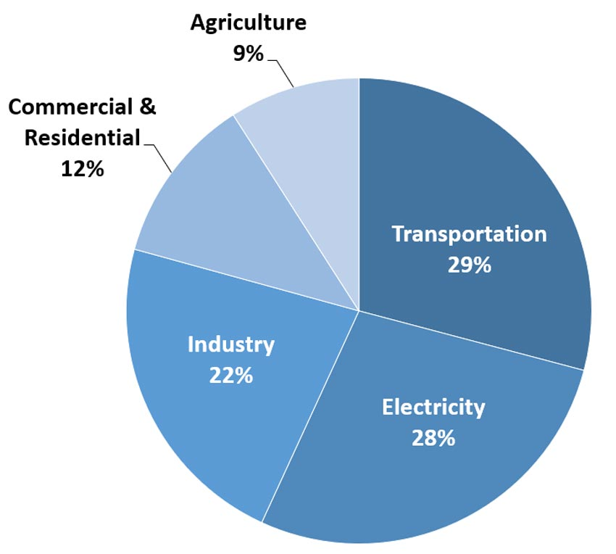
There are also theories that the electrical energy consumed by the EVs can give rise to GHG emission from the power plants, which have to produce more because of the extra load added in form of EVs. The power generation from coal and natural gas will produce more CO₂ from EV penetration than ICEs. However, all the power is not generated from such resources. There are many other power generating technologies that produce less GHG. With those considered, the GHG production from power plants because of EV penetration is less than the amount produced by equivalent power generation from ICE vehicles. The power plants also produce energy in bulk, thus minimizing the per unit emission. With renewable sources integrated properly, which the EVs can support strongly, the emission from both power generation and transportation sector can be reduced.
Fig. 15. Total U.S. GHG emission by economic sector in 2017.

Slide 21
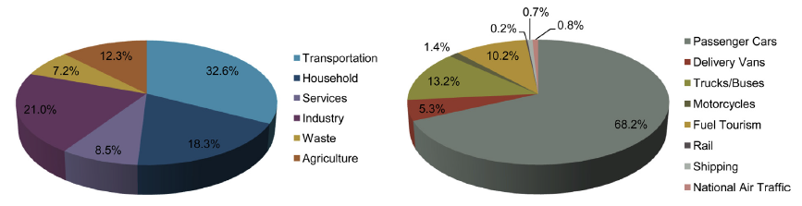
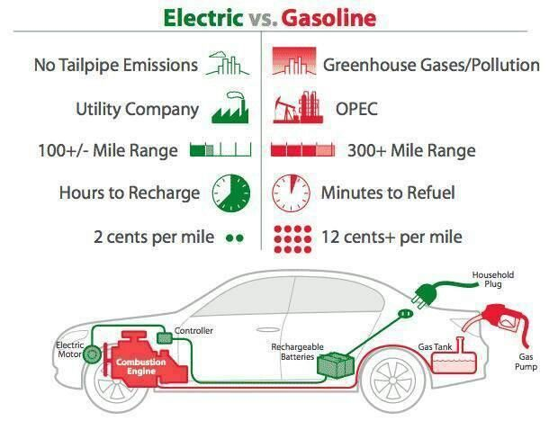
Fig. 16. Annual GHG emissions in Switzerland by sector (left) and within the transportation sector (right).
Fig. 17. A general comparison between the EVs and ICE vehicles in some of usual aspects.

Slide 22
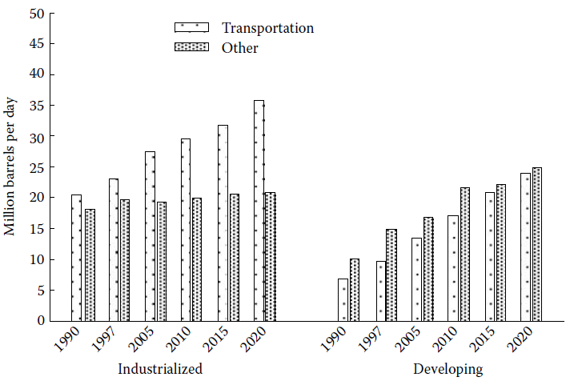
Fig. 18. World oil consumption in transportation and others for industrialized and developing countries.

Slide 23
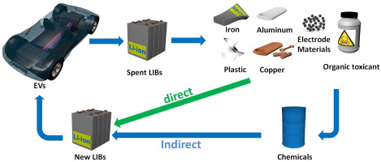
Lower noise Production: which can reduce sound pollution, mostly in urban areas due to eliminating combustion in the propulsion system.
Recycling problem of the batteries: raises serious concerns though, as there are few organizations capable of recycling the lithium-ion batteries fully. However, like the previous nickel-metal and lead-acid ones, lithium-ion cells are not made of caustic chemicals, and their reuse can reduce ‘peak lithium’ or ‘peak oil’ demands.
Fig. 19. Cycle of Li-Ion battery reproduction.

Slide 24
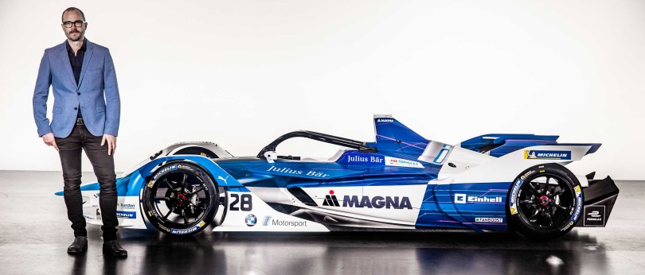
5.1.3. Impacts on economy
Low operating cost: From the perspective of the EV owners, EVs provide less operating cost because of their superior efficiency (Tank to Wheels); it can be up to 70% where ICE vehicles have efficiencies in the range of 15% to 25%. The current high cost of EVs is likely to come down from mass production and better energy policies, which will further increase the economic gains of the owners.
Chances to benefit from V2G: V2G also allows the owners to obtain a financial benefit from their vehicles by providing service to the grid. The power service providers benefit from EV integration mainly by implementing coordinated charging and V2G. It allows them to adopt better peak shaving strategies as well as to integrate renewable sources. EV fleets can lead to $200 to $300 savings in cost per vehicle per year.
5.1.4. Impacts on sport
Hybrid technologies are not used extensively in motor sports to enhance the performance of the vehicles. EVs now have their own formula racing series named ‘Formula E’, which started in Beijing in September 2014.
Autonomous EVs are also being planned to take part in a segment of this series called ‘Roborace’.

Slide 25
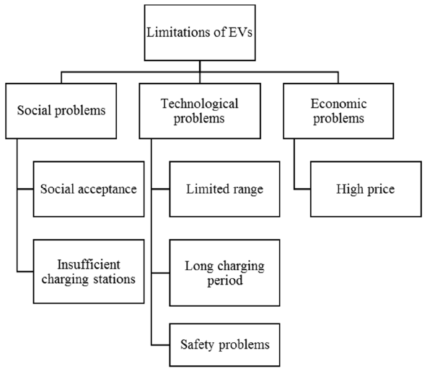
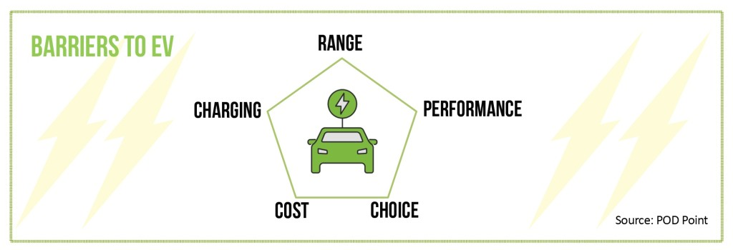
5.2. EV public adoption: barriers, optimization techniques, future developments;
Fig. 20. Social, technological, and economic problems faced by EVs.

Slide 26
5.2.1. Social problems
Social acceptance: The acceptance of a new and immature technology, along with its consequences, takes some time in the society as it means change of certain habits. Using an EV instead of a conventional vehicle means some changes that are not easy to adopt:
change of driving patterns;
refueling habits;
preparedness to use an alternative transport in case of low battery.
Insufficient charging stations: Though public charging stations have increased a lot in number, still they are not enough. Coupled with the lengthy charging time, this acts as a major deterrent against EV penetration. Not all the public charging stations are compatible with every car as well; therefore it also becomes a challenge to find a proper charging point when it is required to replete the battery. There is also the risk of getting a fully occupied charging station with no room for another car.
Tesla and Nissan have been expanding their own charging networks, as it, in turn means they can sell more of their EVs. Hydrogen refueling stations are not abundant yet as well. It is necessary as well to increase the adoption of FCEVs.
To get the better out of the remaining stations, there are different trip planning applications, both web based and manufacturer provided, which helps to obtain a route so that there are enough charging facilities to reach the destination.

Slide 27
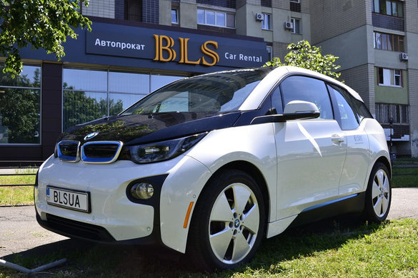
5.2.2. Technological problems
The main obstacles that have frustrated EVs’ domination are the drawbacks of the related technology. Batteries are the main area of concern as their contribution to the weight of the car is significant. Range and charging period also depend on the battery. These factors, along with a few others, are demonstrated below:
Limited range: EVs are held back by the capacity of their batteries. The range indicates the concern about finding a charging station before the battery drains out. The range also depends on:
speed of the vehicle;
driving style;
cargo the vehicle is carrying;
terrain it is being driven on;
energy consuming services (air conditioning, …).
range anxiety remains a major obstacle for EVs to overcome. This does not affect the use of EVs for urban areas though, as in most cases this range is enough for daily travelling inside city limits.
Range extenders, which produce electricity from fuel, are also available with models like BMW i3 as an option. Vehicles with such facilities are currently being called as Extended Range Electric Vehicles (EREV).

Slide 28
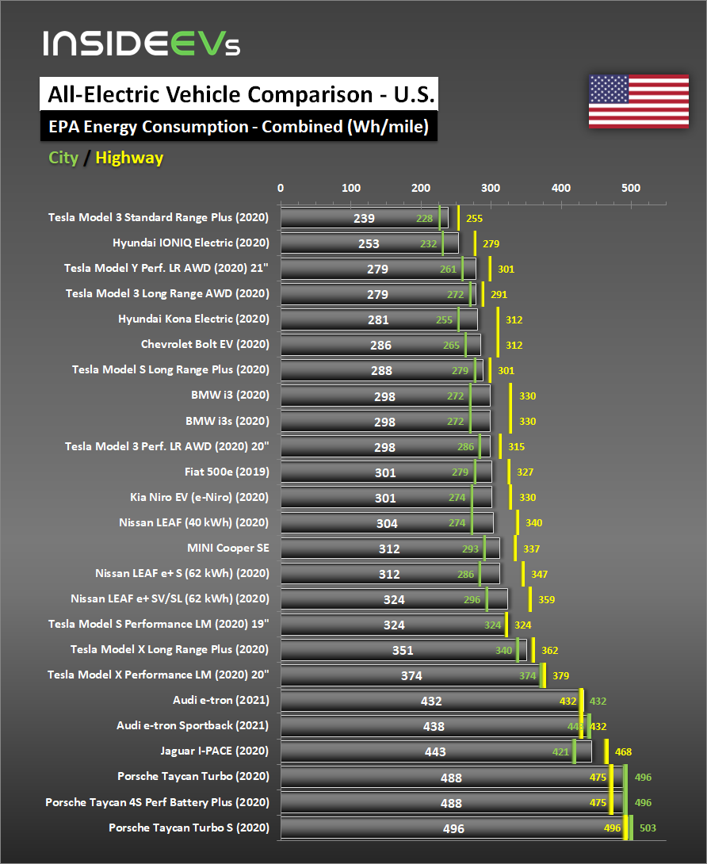
Fig. 21. All-electric range of some of the EVs in city and highway condition driving.

Slide 29
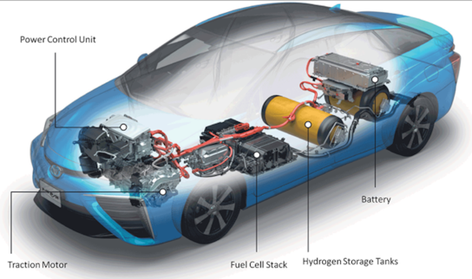
Long charging period: Depending on the type of a charger and a battery pack size, charging can take from a few minutes to hours; this truly makes EVs incompetent against the ICE vehicles which only take a few minutes to get refueled (to have an hour decreased from the charging time, people are willing to pay $425–$3250). A way to make the charging time faster is to increase the voltage level and employment of better chargers.
There are also the FCEV that do not require charging like other EVs. Filling up the hydrogen tank is all that has to be done in case of these vehicles, which is as convenient as filling up a fuel tank, but FCEVs need:
sufficient Hydrogen refueling stations ;
feasible way to produce the Hydrogen in order to thrive.
Safety concerns: The concerns about safety are rising mainly about the FCEVs nowadays. There are concerns that, if hydrogen escapes the tanks it is kept into, can cause serious harm, as it is highly flammable. It has no color either, making a leak hard to notice. There is also the chance of the tanks to explode in case of a collision.
To counter these problems, the automakers have taken measures to ensure the integrity of the tanks; they are wrapped with carbon fibers in case of the Toyota Mirai. In this EV, the hydrogen handling parts are placed outside the cabin, allowing the gas to disperse easily in case of any leak. there are also arrangements to seal the tank outlet in case of high-speed collision.

Slide 30
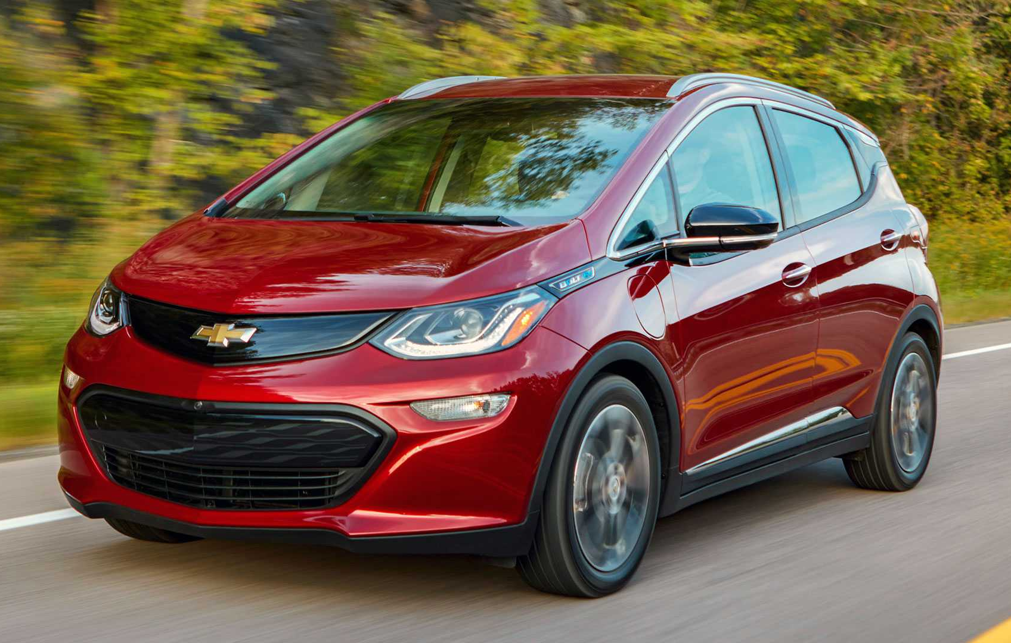
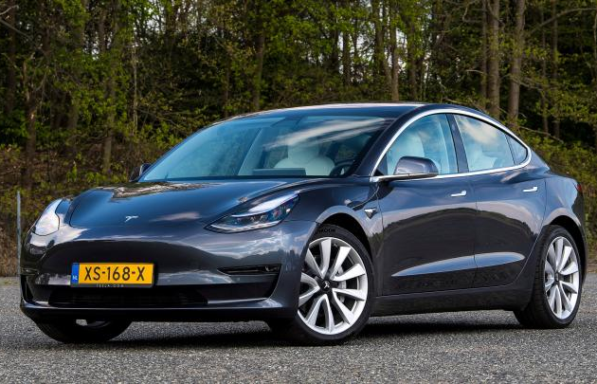
5.2.3. Economical problems
High price: The price of the EVs is quite high compared to their ICE counterparts. This is because of the high cost of batteries and fuel cells. To make people overlook this factor, governments in different countries including the UK and Germany, have provided incentives and tax breaks which provide the buyers of EVs with subsidies. Mass production and technological advancements will lead to a decrease in the prices of batteries as well as fuel cells.
Affordable EVs with a long range like Chevrolet Bolt has already appeared in the market, while another vehicle with the same promises (Tesla Model 3) is anticipated to arrive soon.

Slide 31
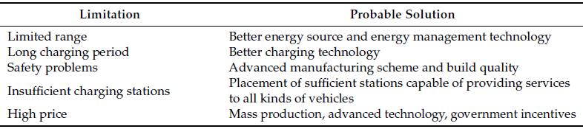
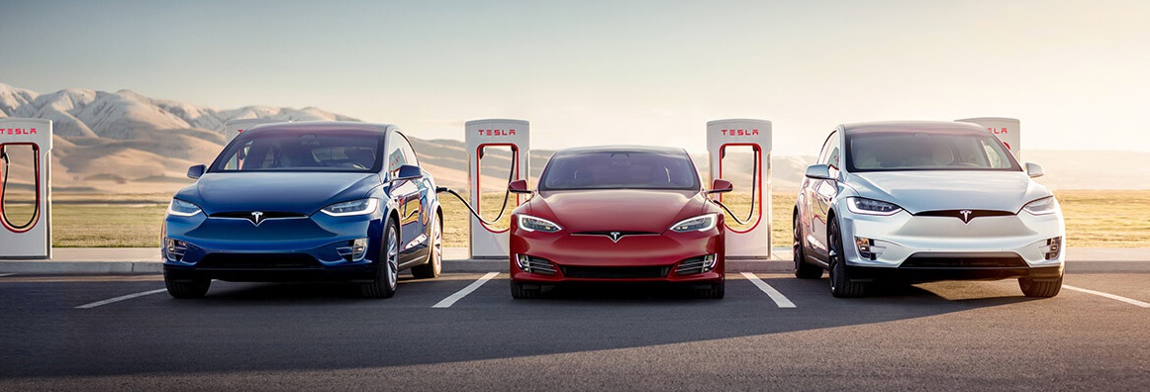
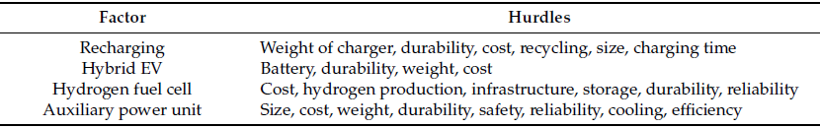
Table 4. Tentative solutions for current limitations of EVs.
Table 5. Hurdles in key EV factors.

Slide 32
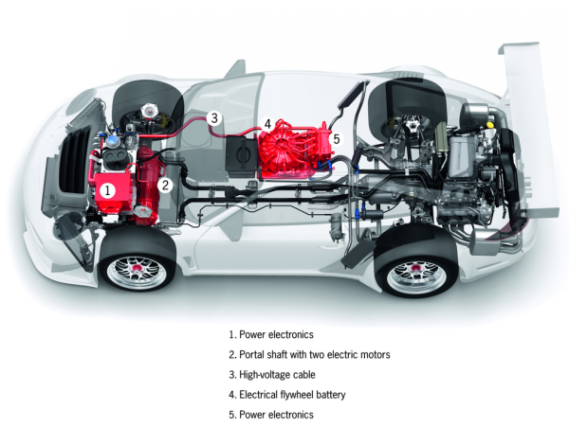
5.2.4. Optimization techniques of EVs
The energy consuming accessories on a car include:
power steering,
air conditioning,
lights,
infotainment systems etc.
Operating these in an energy efficient way or turning some of these off can increase the range of a vehicle.
LEDs can be used for lighting because of their high efficiency.
To make the best out of the available energy, EVs apply various aerodynamics and mass reduction techniques, and lightweight materials are used to decrease the body weight as well.
Regenerative braking is used to restore energy lost in braking. The restored energy can be stored in different ways:
can be stored directly in the ESS;
can be stored by compressing air by means of hydraulic motor;
can be store by springs, in form of gravitational energy.
Formula One vehicles employ kinetic energy recovery systems (KERSs) to use the energy gathered during braking to provide extra power during accelerating. The Porsche 911 GT3R hybrid uses a flywheel energy storage system to store this energy.

Slide 33
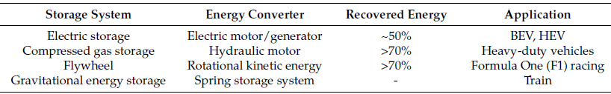
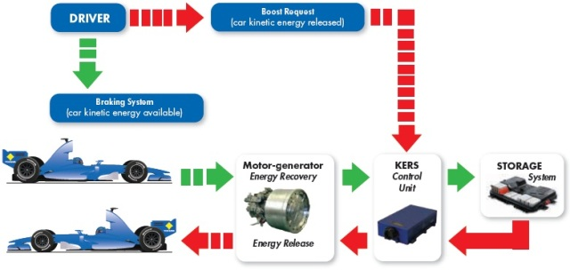
Table 6. Different methods of recovering energy during braking.
Fig. 22. Regenerative braking cycle for EVs.

Slide 34

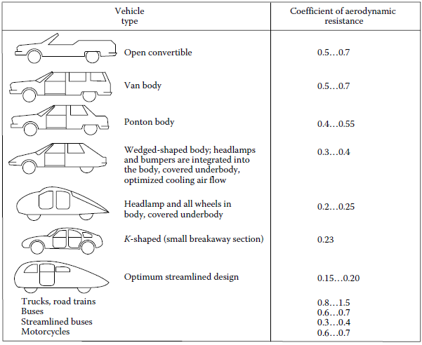
Aerodynamic techniques are used in vehicles to reduce the drag coefficient, which reduces the required power. Power needed to overcome the drag force is:
C_{d} is the drag coefficient. The Toyota Prius claims a drag coefficient of 0.24 for the 2017 model, the same as the Tesla Model S. The 2012 Nissan Leaf had this value set at 0.28.
Fig. 23. Indicative drag coefficients for different body shapes.

Slide 35
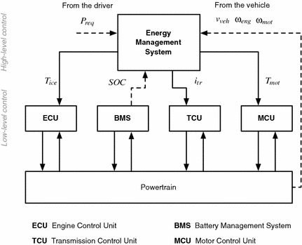
Different energy management schemes can be employed to ensure efficient use of the available energy, . Presented control strategies for energy management included systems using fuzzy logic, deterministic rule and optimization based schemes:
Geng et al., worked on a plug-in series hybrid FCV. The objective of their control system was to consume the minimum amount of hydrogen while preserving the health of the proton exchange membrane fuel cell (PEMFC). The control system was comprised of two stages; the first stage determined the SOC and control references, whereas the second stage determined the PEMFC health parameters. This method proved to be capable of reducing the hydrogen consumption while increasing the life-time to the fuel cell.
Murphey et al., examined another intelligent management system, which used machine learning combined with dynamic programming to determine energy optimization strategies for roadway and traffic-congestion scenarios for real-time energy flow control of a hybrid EV. Their system is simulated using a Ford Escape Hybrid model; it revealed the system was effective in finding out congestion level, optimal battery power and optimal speed.
Fig. 24. EMS of a HEV and its communication with other parts.

Slide 36
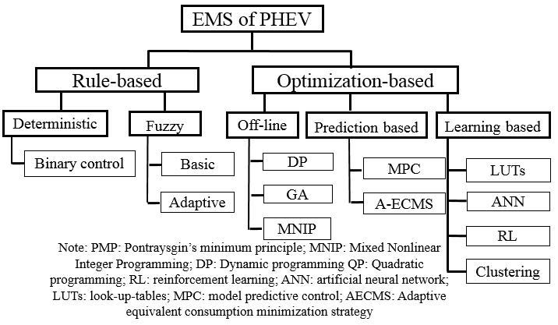
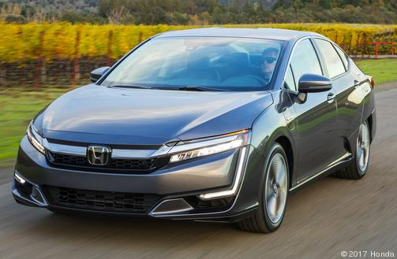
Geng et al., proposed a control mechanism for energy management for a PHEV employing batteries and a micro turbine. They introduced a new parameter, named the “energy ratio”, to produce the equivalent factor, which was used in the popular Equivalent Consumption Minimization Strategy (ECMS) to deduce the minimum driving cost by applying Pontryagin’s minimum principle. This method claimed to reduce the cost by 7.7–21.6%.
Moura et al., explored efficient ways to split power demand among different power sources of mid-sized sedan PHEVs. They used a number of drive cycles, rather than a single one, assessed the potential of depleting charge in a controlled manner, and considered relative pricing of fuel and electricity for optimal power management of the vehicle.
Fig. 25. Various EMS schemes for PHEVs.

Slide 37
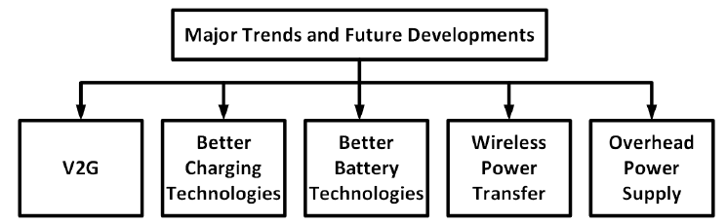
5.2.5. Future developments of EVs
Fig. 26. Major trends and sectors for future developments for EVs.
The adoption of EVs has opened doors for new possibilities and ways to improve both the vehicles and the systems associated with it, which are as:
V2G is the link between these EV and smart grid technologies and both get benefitted from it. With V2G comes other essential systems required for a sustainable EV scenario: charge scheduling, Virtual Power Plant (VPP), smart metering etc.
The existing charging technologies have to improve: The charging time has to be decreased extensively for making EVs more flexible. At the same time, chargers and Electric Vehicle Supply Equipment (EVSE) have to able to communicate with the grid for facilitating V2G, smart metering, and if needed, bidirectional charging.
There is a need for batteries that use non-toxic materials and have higher power density, less cost and weight, more capacity, and needs less time to recharge. Though technologies better than Li-ion have been discovered already, they are not being pursued industrially because of the huge costs associated with creating a working version. Li-air batteries could be a good option to increase the range of EVs.

Slide 38
WPT systems are likely to replace the current cabled charging system. Electric roads for wireless charging of vehicles may appear as well. Vehicles that follow a designated route along the highway, like trucks, can get their power from overhead lines like trains or trams. It will allow them to gather energy as long as their route resides with the power lines, then carry on with energy from on-board sources. Such a system has been tested by Siemens using diesel-hybrid trucks from Scania on a highway in Sweden.
New ways of recovering energy from the vehicle may appear. Goodyear has demonstrated a tire that can harvest energy from the heat generated there using thermo-piezoelectric material. There are also chances of solar-powered vehicles. Until now, these have not appeared useful as installed solar cells only manage to convert up to 20% of the input power.
Various power supply for on-board charging with higher efficiency and better power quality are considered as the main power electronics topics for EV applications.
Much research is going on to make the electronics and sensors in EVs more compact, rugged and cheaper. Some examples can be the works on gas sensors, smart LED drivers, smart drivers for automotive alternators, advanced gearboxes, and compact and smart power switches to weather harsh conditions.
EVs are likely to move away from using PM motors, which use rare-earth materials. The motors of choice can be induction motor, synchronous reluctance motor, and switched reluctance motor. Motors with internal permanent magnet may stay in use.

Slide 39
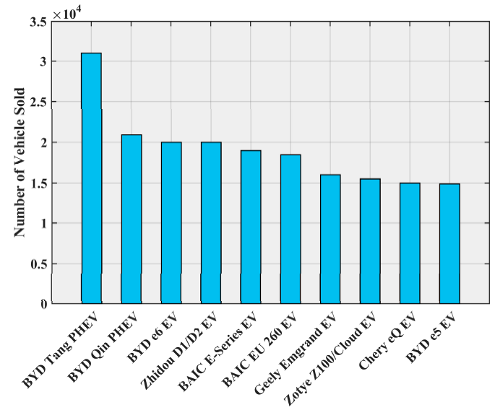
5.3. EVs Global Market: Current State and Future
5.3.1. Current state of EVs market
China has become the largest market for EVs (35.4% of the worldwide EV scene in 2017, an rise from the mere 6.3% in 2013).
China has the greatest number of manufacturers, led by BYD autos, which sold 96,000 EVs in 2016. This drive in China is fueled by government initiatives adopted to promote EV use to mitigate the country’s serious air pollution.
China huge market has attracted major carmakers all over the world (Ford, Volkswagen, Volvo, and General Motors).
Fig. 27. Top ten EVs in China in 2016 according to the number of units sold.

Slide 40
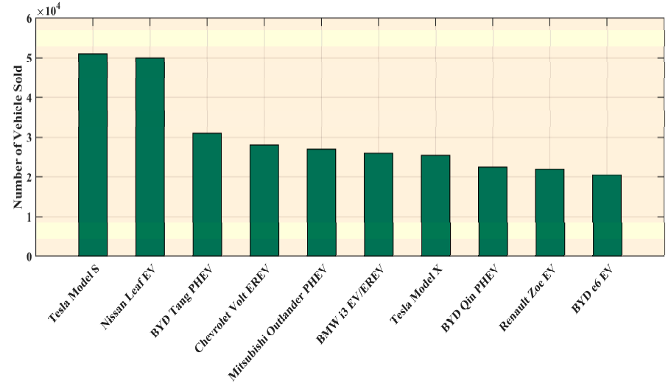
From a global perspective, sales of EV grew by 36% in the USA; Europe saw a growth of 13%, while Japan observed a decrease of 11% in the same period.
BYD dominated the global market with a 13.2% share, followed by Tesla in second place (9.9%); the other major contributors can be listed as Volkswagen Group, BMW Group, Nissan, BAIC, and Zoyte.
Tesla Model S remained the best-selling EV in 2016 with 50,935 units sold, followed by the Nissan Leaf EV with 49,818 units.
Fig. 28. Top ten best-selling EVs globally in 2016.

Slide 41
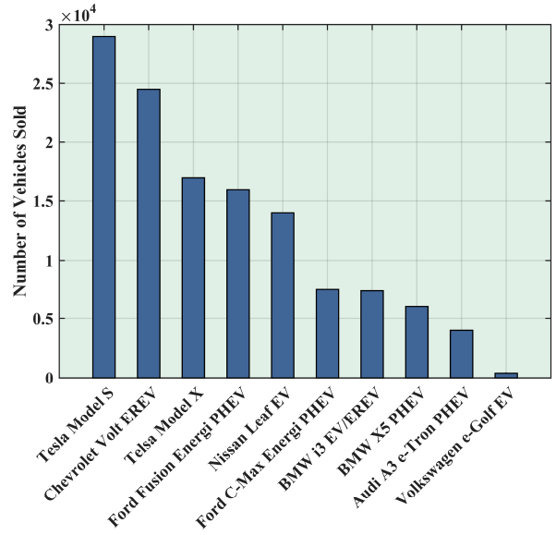
The American market was dominated predictably by the Tesla Model S in 2016, 28,821 of these were sold; Chevrolet Volt EREV sold 24,739 units, thus securing the second place. The third place was achieved by another Tesla Model X; 18,192 of these Sport Utility Vehicles (SUVs) were sold in 2016.
Fig. 29. Top ten best-selling EVs in the USA in 2016.

Slide 42
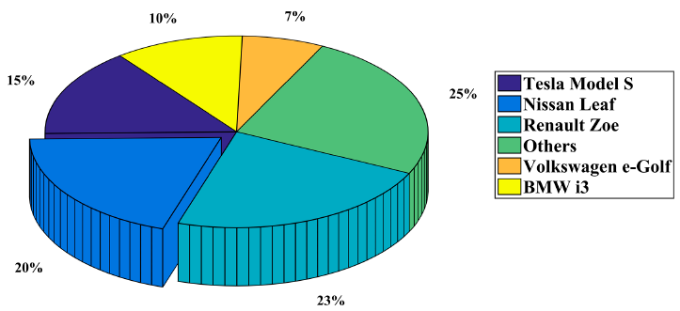

The Renault Zoe was the best-selling BEV in Europe in 2016, with 21,338 units sold, followed by the Nissan Leaf with 18,614 units.
In the PHEV segment, the Mitsubishi Outlander PHEV was the market leader in Europe in 2016, with 21,333 units sold; the Volkswagen Passat GTE held the second position with 13,330 units].
Fig. 30. BEV market shares in Europe in 2016.
Fig. 31. PHEV market shares in Europe in 2016.

Slide 43

Fig. 32. Some of sold famous EVs in U.S. with price and acceleration.

Slide 44

Fig. 33. Some of sold famous EVs in U.S. with price and all electric range according to EPA report.

Slide 45

Fig. 34. Various Tesla EVs comparison in range, acceleration, and price.

Slide 46

Fig. 35. Statistics of light-duty plug-in EVs on the road in Netherlands from 2011 to 2020.

Slide 47

Fig. 36. Annual registration statistics of plug-in EVs in the UK from 2011 to 2020.

Slide 48

Fig. 37. Annual registration statistics of plug-in passenger EVs in Europe from 2011 to 2020.

Slide 49

Fig. 38. Annual sales statistics of EVs in China from 2011 to 2020.

Slide 50

Fig. 39. Annual sales statistics of EVs in the U.S. from 2011 to 2019.

Slide 51

Fig. 40. BEV and PHEV sales trend comparison in 2010-2017.

Slide 52




Table 7. Automakers EV sales comparison in 2018.

Slide 53

Fig. 41. Luxury car sales comparison in 2018.
About the EU Automotive industry:
12.2 million people - or 5.6% of the EU employed population - work in the sector.
The 3.1 million jobs in automotive manufacturing represent 10.4% of EU manufacturing employment.
Motor vehicles account for over €400 billion in tax contributions in the EU15.
The sector is also a key driver of knowledge and innovation, representing Europe's largest private contributor to R&D, with €44.7 billion invested annually.
The automobile industry generates a trade surplus of €100.4 billion for the EU.

Slide 54

Table 8. Specifications of some commercially available EVs.

Slide 55


5.3.2. Future perspective for EV market
The historic learning rate for EV Li-ion battery prices from 2010-2017 was around 18%. This means that for every doubling of cumulative volume, we observe an 18% reduction in cost. Based on this, we expect battery prices to continue to decline, reaching $96/kWh in 2025 and $70/kWh in 2030.
Fig. 42. Li-ion battery price trend till now (upper) and in the future (lower).
The price for lithium-ion battery packs has fallen by 24% since 2016 and 79% since 2010.

Slide 56


Fig. 43. Global e-bus Li-ion battery demand and global EV lithium-ion battery manufacturing capacity.
In 2017 battery demand from e-buses was slightly lower than in 2016, as a result of the drop in e-bus sales in China. The majority of Li-ion battery manufacturing capacity is located in China.
Fig. 44. Li-ion battery pack price forecast.

Slide 57

The location of battery manufacturing also plays an important role in determining costs. Factors such as local electricity costs, labor and financing will also affect the cost of manufacturing. Battery prices in China are currently the lowest at both pack and cell level, due to a combination of scale of manufacturing, labor costs, electricity prices and favorable local conditions. This in turn allows e-buses made in China to be considerably cheaper than in the rest of the world. We estimated the manufacturer’s price for the electric BYD K9 at around 1.75 million Yuan ($264,000) – significantly less than e-buses on offer in Europe or the U.S.
Fig. 45. EV parts price trend in the future.

Slide 58

Fig. 46. EV sales trend in the future in various countries of the world.

Slide 59



















































5.3.3. Job opportunities based on EVs
تولید باتری
اجاره باتری
بازیافت باتری
دوچرخه و اسکوتر
خودروهای شخصی و پیکاب‌ها
بازسازی
شرکت‌های
تولید کننده وسائط نقلیه
تامین کنندگان انرژی الکتریکی
خودروهای تجاری
زیرساخت
اتصال خودرو
به شبکه
پلت‌فرم‌های
اشتراکی
خودروی
اشتراکی
مدیریت شارژ
اشتراک وسائط نقلیه
Fig. 47. Fields of activities for automakers and infrastructure producers.

Slide 60






ایستگاه شارژ
باتری
وسائط نقلیه الکتریکی
انرژی برق
خدمات ارزش افزوده
خدمات و تولید
تولید و فروش
تولید باتری
تولید وسائط نقلیه
اشتراک بسته های حق اشتراک خدمات انرژی
مدیریت دیتا
نصب، تعمیر و نگهداری
اجاره باتری
گسترش روش‌های حمل و نقل الکتریکی مانند حمل و نقل اشتراکی
مدیریت مصرف برق
خدمات مدیریت باتری
خدمات پرداخت شارژ
بازسازی باتری
خدمات پس از فروش
پلت فرم مبتنی بر IT حمل و نقل الکتریکی
سرمایه گذاری در انرژی‌های تجدید پذیر
جریان‌های درآمدی ممکن
جریان درآمدی از خدمات ارزش افزوده
بازیافت باتری
ارتباطات v2v و v2g
بازسازی و بازیافت
کسب درآمد مستقیم از برق در ساعات اوج مصرف و ساعت کم مصرف
شارژ بر پایه انرژی های تجدیدپذیر
باتری دست دوم
خدمات ارزش افزوده
ایستگاه های شارژ متحرک
تعویض باتری
کسب درآمد مستقیم از فروش انرژی تجدید پذیر تجدید ناپذیز
عرضه برق در زمان پیک
کوچک سازی باتری پک در خودروهای الکتریکی
Fig. 48. Fields of economical activities based on EV industry.

